Slide 1
DATA LINK CONTROL

Slide 2
Data Link Layer Design Issues
Services Provided to the Network Layer
Framing
Error Control
Flow Control

Slide 3
FRAMING
The data link layer needs to pack bits into frames, so that each frame is distinguishable from another. Our postal system practices a type of framing. The simple act of inserting a letter into an envelope separates one piece of information from another; the envelope serves as the delimiter.
Topics discussed in this section:
Fixed-Size Framing Variable-Size Framing

Slide 4
Types of Framing
Fixed Size Framing
Variable Size Framing--- Character oriented protocols and Bit oriented Protocols.

Slide 5
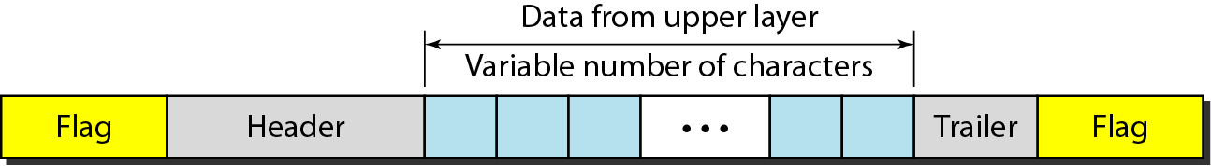
A frame in a character-oriented protocol

Slide 6
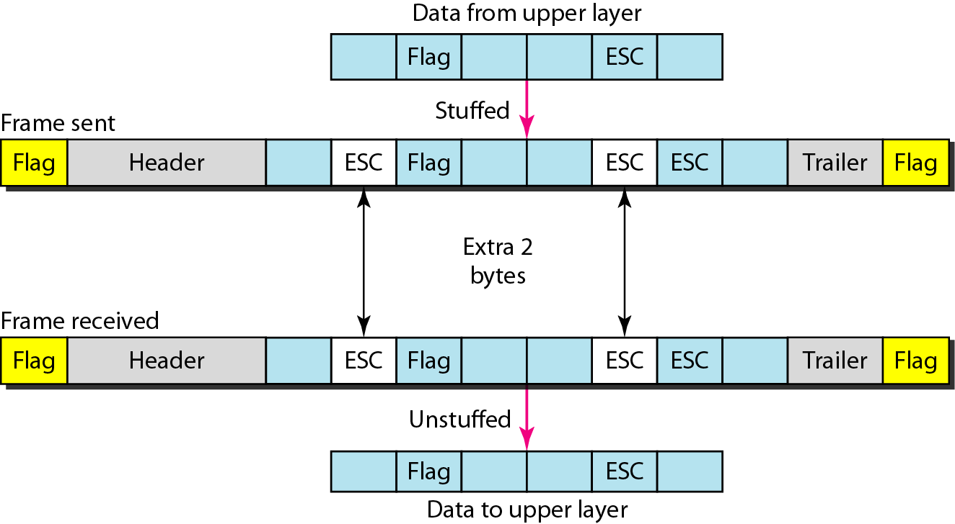
Byte stuffing and unstuffing

Slide 7

Note
Byte stuffing is the process of adding 1 extra byte whenever there is a flag or escape character in the text.

Slide 8
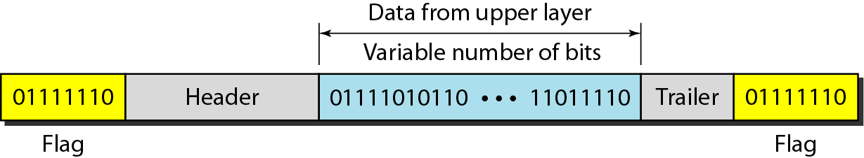
A frame in a bit-oriented protocol

Slide 9
Note
Bit stuffing is the process of adding one extra 0 whenever five consecutive 1s follow a 0 in the data, so that the receiver does not mistake
the pattern 0111110 for a flag.

Slide 10
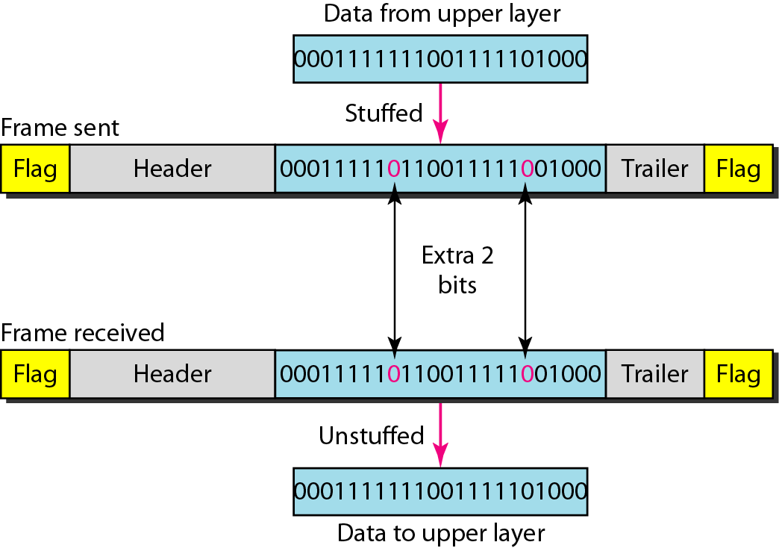
Bit stuffing and unstuffing

Slide 11
FLOW AND ERROR CONTROL
The most important responsibilities of the data link layer are flow control and error control. Collectively, these functions are known as data link control.
Topics discussed in this section:
Flow Control Error Control

Slide 12
Note
Flow control refers to a set of procedures used to restrict the amount of data
that the sender can send before
waiting for acknowledgment.

Slide 13
Note
Error control in the data link layer is based on automatic repeat request, which is the retransmission of data.

Slide 14
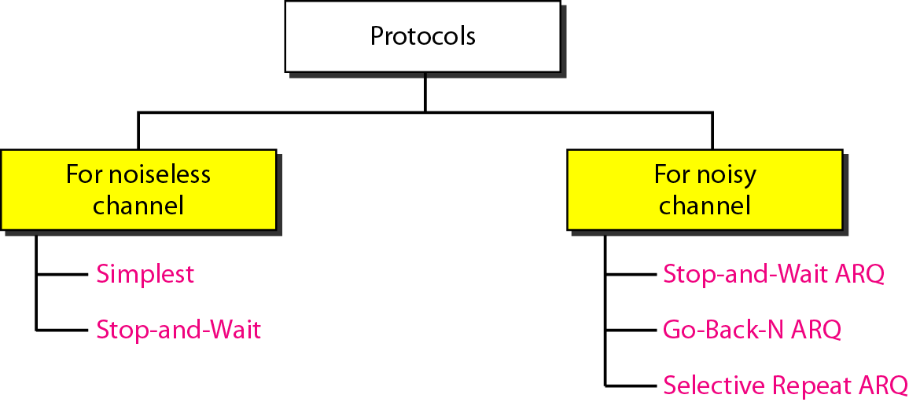
Taxonomy of protocols discussed in this chapter

Slide 15
NOISELESS CHANNELS
Let us first assume we have an ideal channel in which no frames are lost, duplicated, or corrupted. We introduce two protocols for this type of channel.
Topics discussed in this section:
Simplest Protocol Stop-and-Wait Protocol

Slide 16
Simplest Protocol
No flow and Error Control

Slide 17
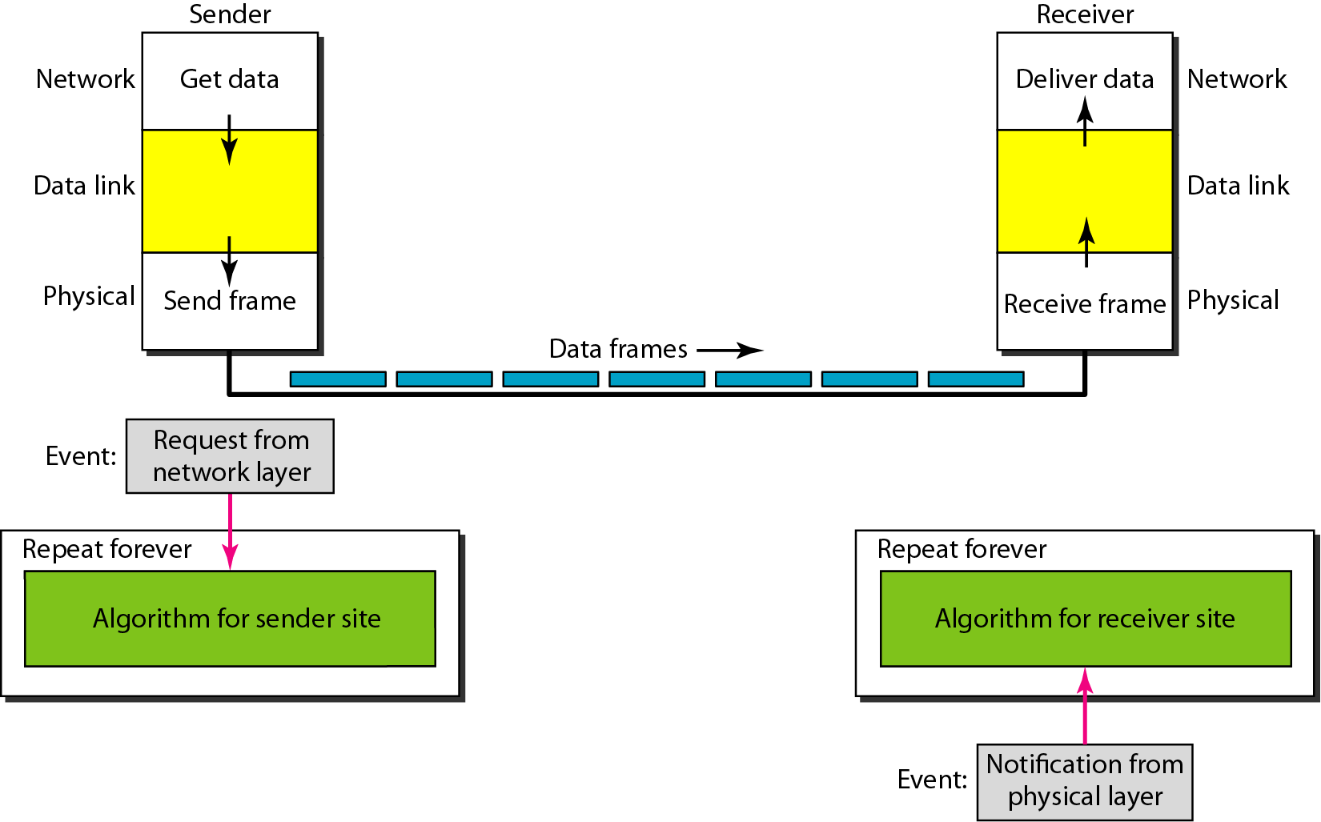
The design of the simplest protocol with no flow or error control

Slide 18
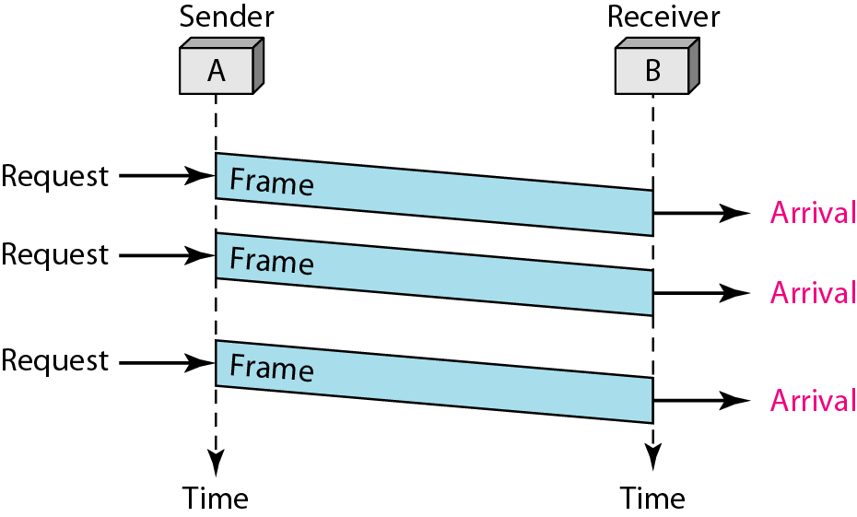
Flow diagram for Simplest

Slide 19
Stop-and-Wait Protocol
Sender sends one frame, stops until it gets confirmation from receiver.

Slide 20
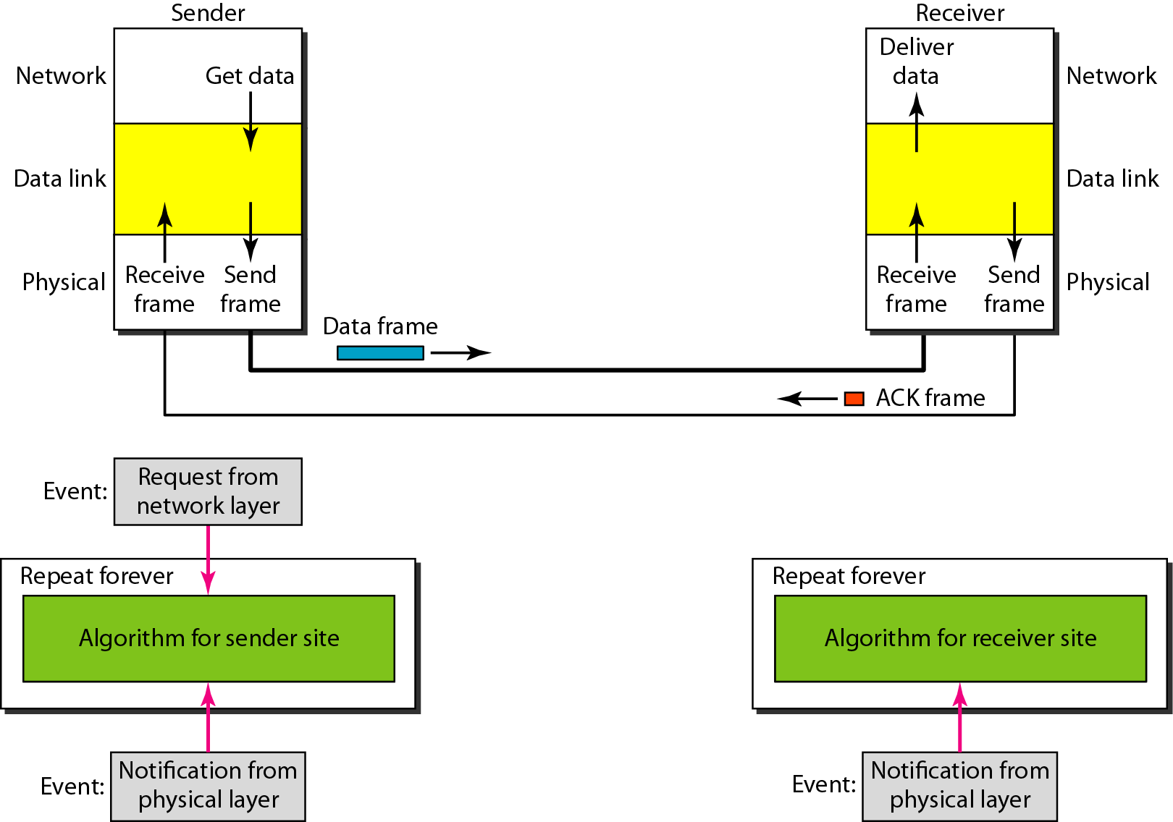
Design of Stop-and-Wait Protocol

Slide 21
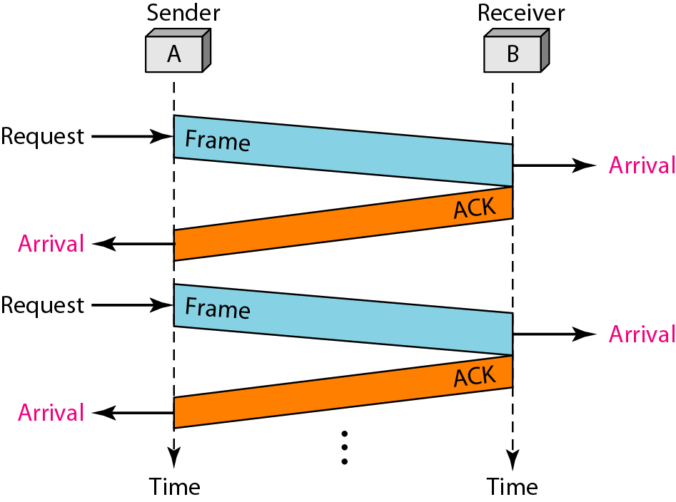
Flow diagram for Stop and Wait

Slide 22
NOISY CHANNELS
Although the Stop-and-Wait Protocol gives us an idea of how to add flow control to its predecessor, noiseless channels are nonexistent. We discuss three protocols in this section that use error control.
Topics discussed in this section:
Stop-and-Wait Automatic Repeat Request Go-Back-N Automatic Repeat Request Selective Repeat Automatic Repeat Request

Slide 23
Note
In Stop-and-Wait ARQ, we use sequence numbers to number the frames.
The sequence numbers can be 1,0,1,0,1…

Slide 24
Note
In Stop-and-Wait ARQ, the acknowledgment number is 0 if sequence number is 1 and acknowledgment number is 1 if sequence number is 0

Slide 25
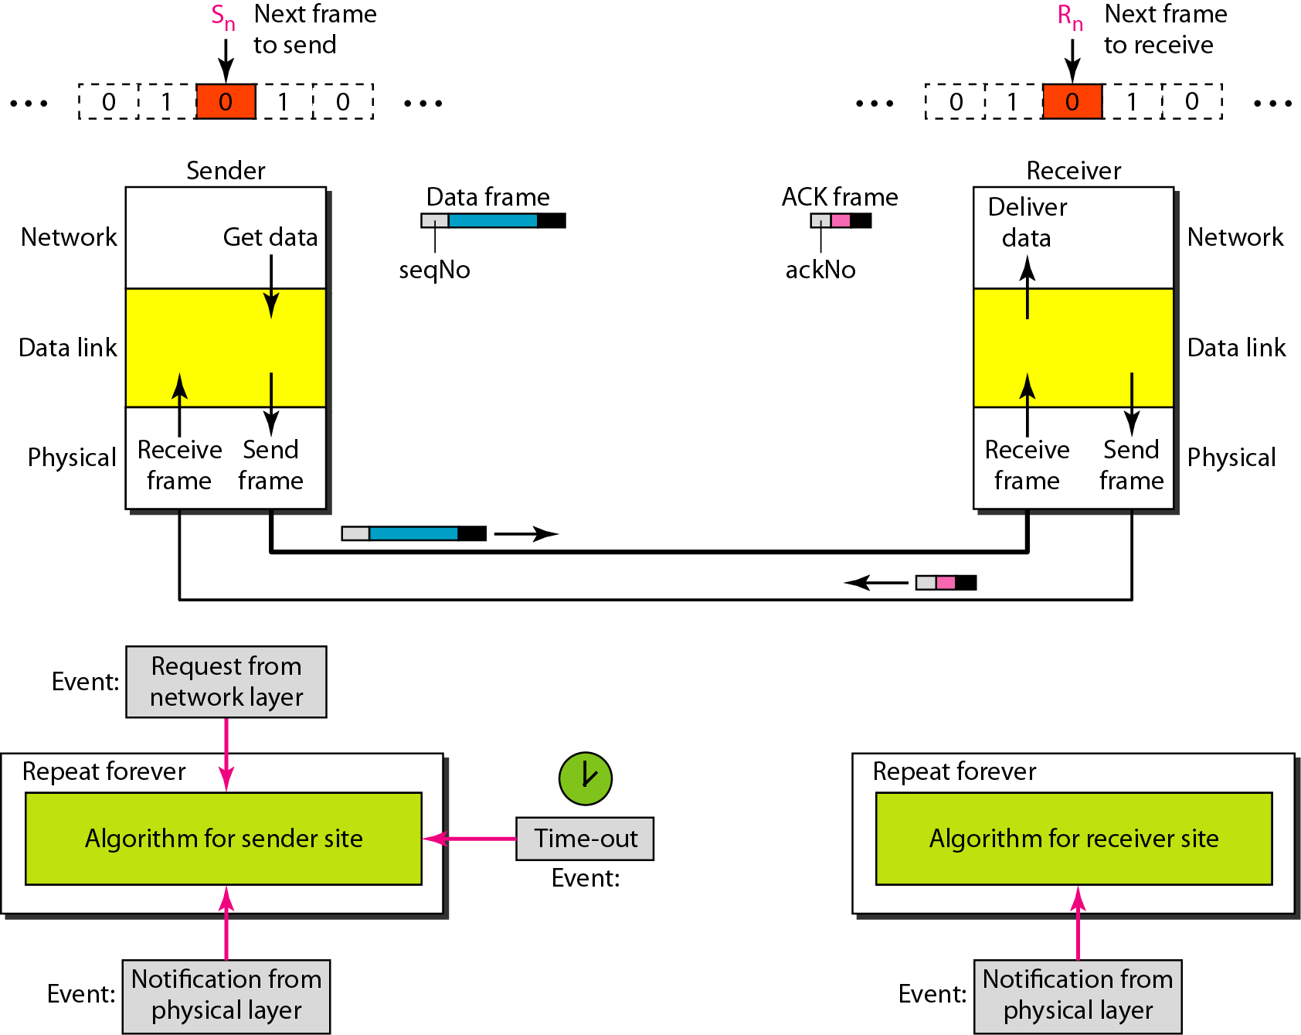
Design of the Stop-and-Wait ARQ Protocol

Slide 26
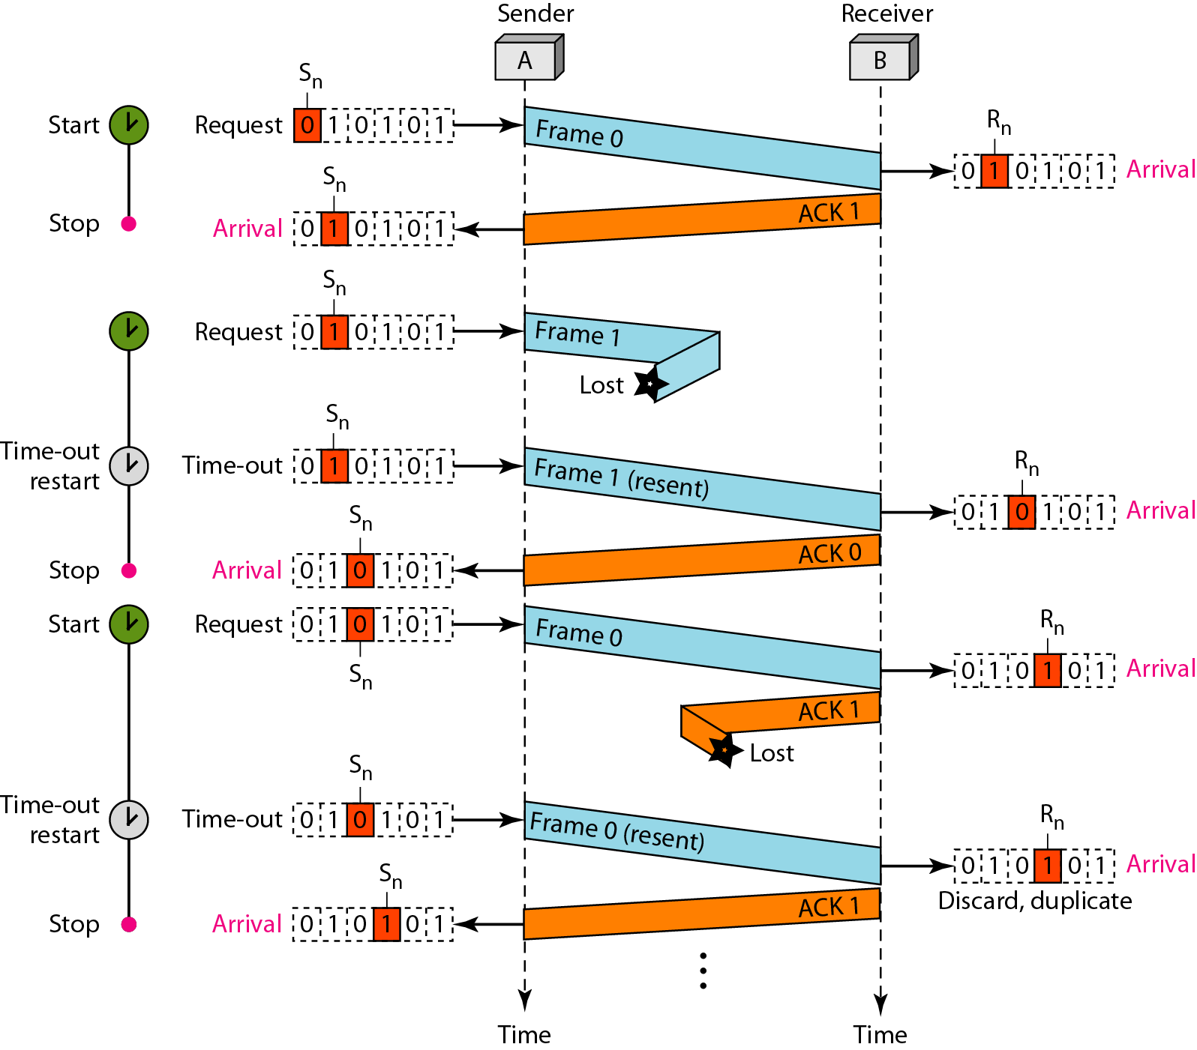
Flow diagram for Example 11.3

Slide 27
Disadvantage Stop-and-Wait ARQ Protocol
Inefficient---if channel is thick and long
Thick means high bandwidth
Long means roundtrip delay
Product of both is bandwidth delay.
Bandwidth delay is number of bits we can send while waiting for news from receiver.

Slide 28
Assume that, in a Stop-and-Wait ARQ system, the bandwidth of the line is 1 Mbps, and 1 bit takes 20 ms to make a round trip. What is the bandwidth-delay product? If the system data frames are 1000 bits in length, what is the utilization percentage of the link?
Solution
The bandwidth-delay product is

Slide 29
The system can send 20,000 bits during the time it takes for the data to go from the sender to the receiver and then back again. However, the system sends only 1000 bits. We can say that the link utilization is only 1000/20,000, or 5 percent. For this reason, for a link with a high bandwidth or long delay, the use of Stop-and-Wait ARQ wastes the capacity of the link.

Slide 30
Pipelining
Task begins before end of first task.
Stop-and-Wait ARQ does not use pipelining but other two techniques do.
This improves efficiency.

Slide 31
Go-Back-N Protocol
This sends multiple frames before receiving acknowledgment from receiver.

Slide 32
Note
In the Go-Back-N Protocol, the sequence numbers are modulo 2^{m},
where m is the size of the sequence number field in bits.

Slide 33
Sliding Window
Defines the range of sequence numbers that is concern of sender and receiver.
The range which is concern of sender is called sender sliding window.
The range which is concern of receiver is called receiver sliding window.

Slide 34
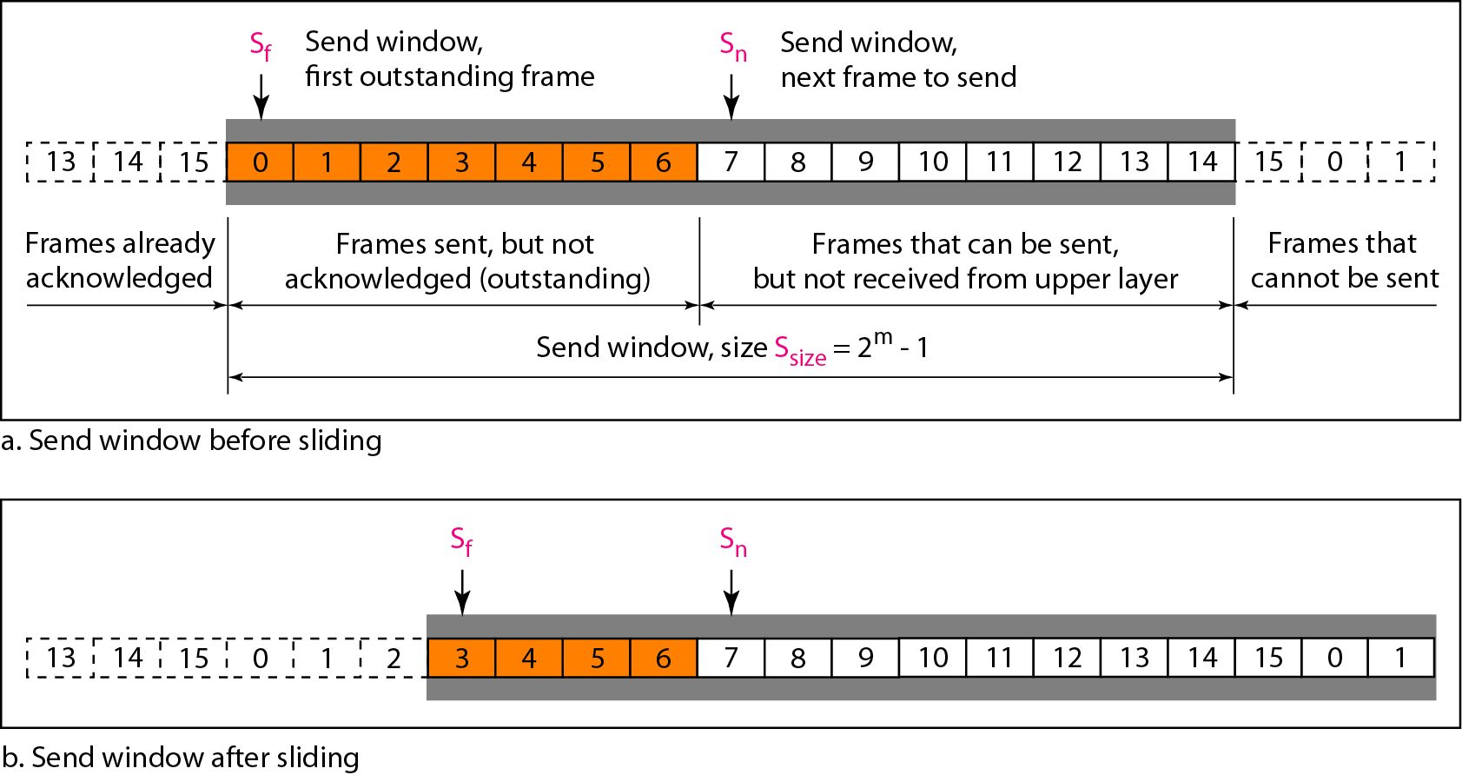
Send window for Go-Back-N ARQ

Slide 35
Note
The send window is an abstract concept defining an imaginary box of size 2^{m} − 1 with three variables: Sf, Sn, and S_{size}.

Slide 36
Note
The send window can slide one or more slots when a valid acknowledgment arrives.

Slide 37
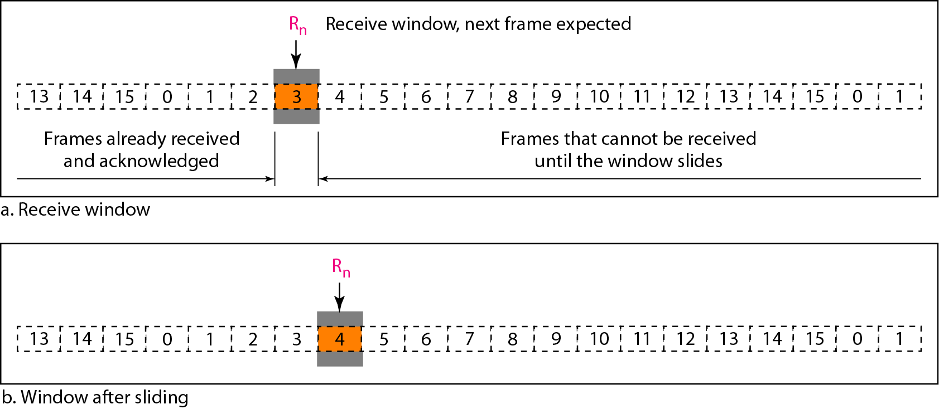
Receive window for Go-Back-N ARQ

Slide 38
Note
The receive window is an abstract concept defining an imaginary box
of size 1 with one single variable R_{n}. The window slides
when a correct frame has arrived; sliding occurs one slot at a time.

Slide 39
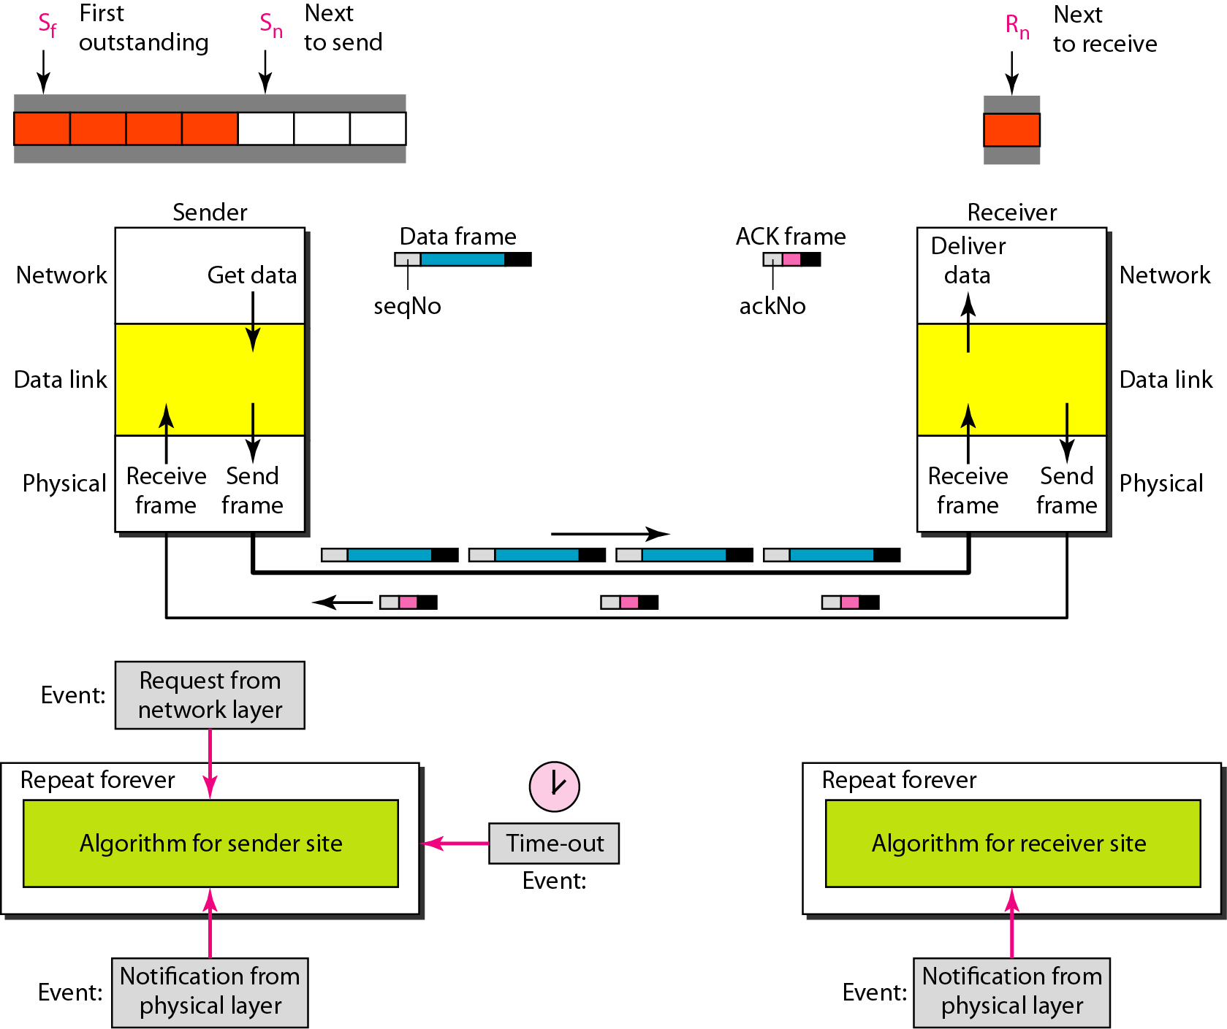
Design of Go-Back-N ARQ

Slide 40
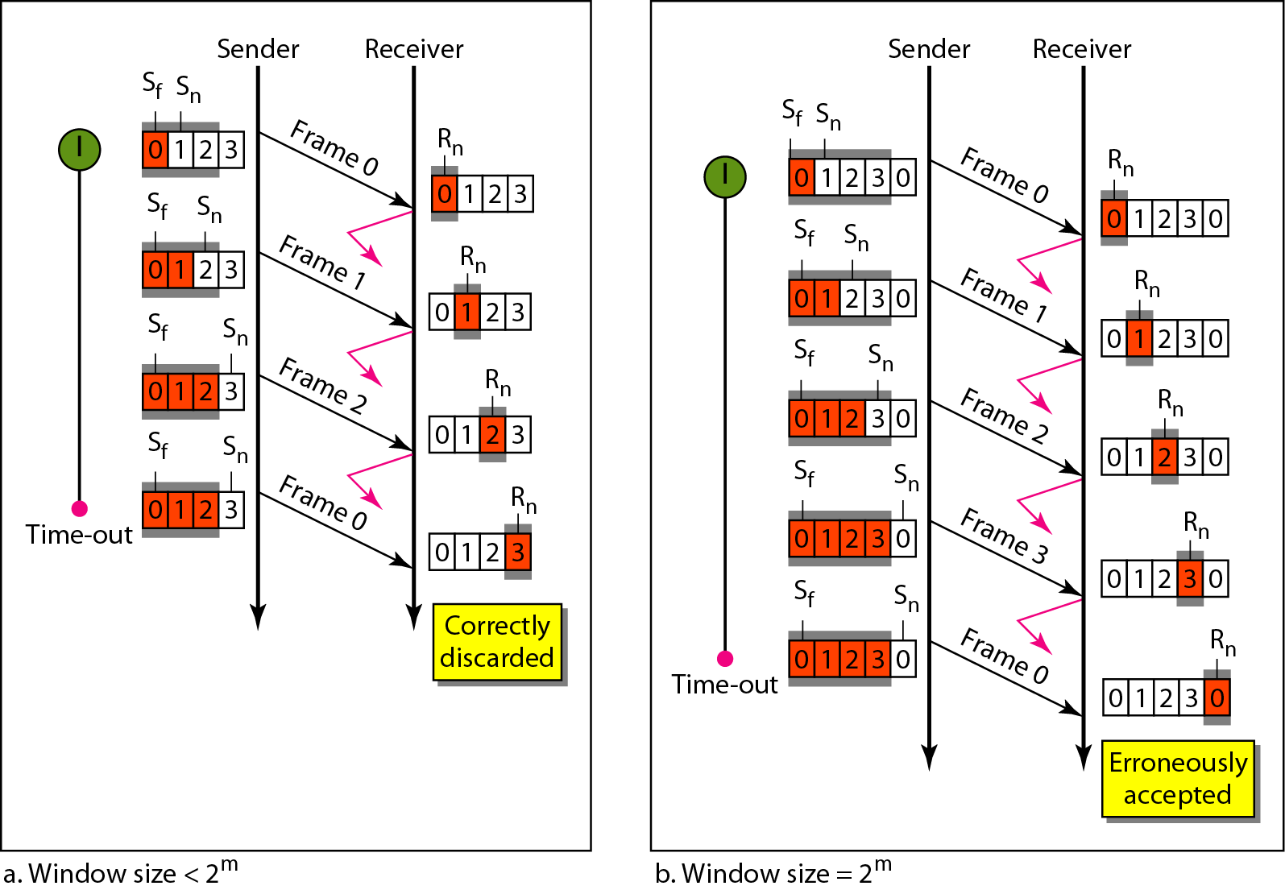
Figure 11.15 Window size for Go-Back-N ARQ

Slide 41
Note
In Go-Back-N ARQ, the size of the send window must be less than 2^{m};
the size of the receiver window is always 1.

Slide 42
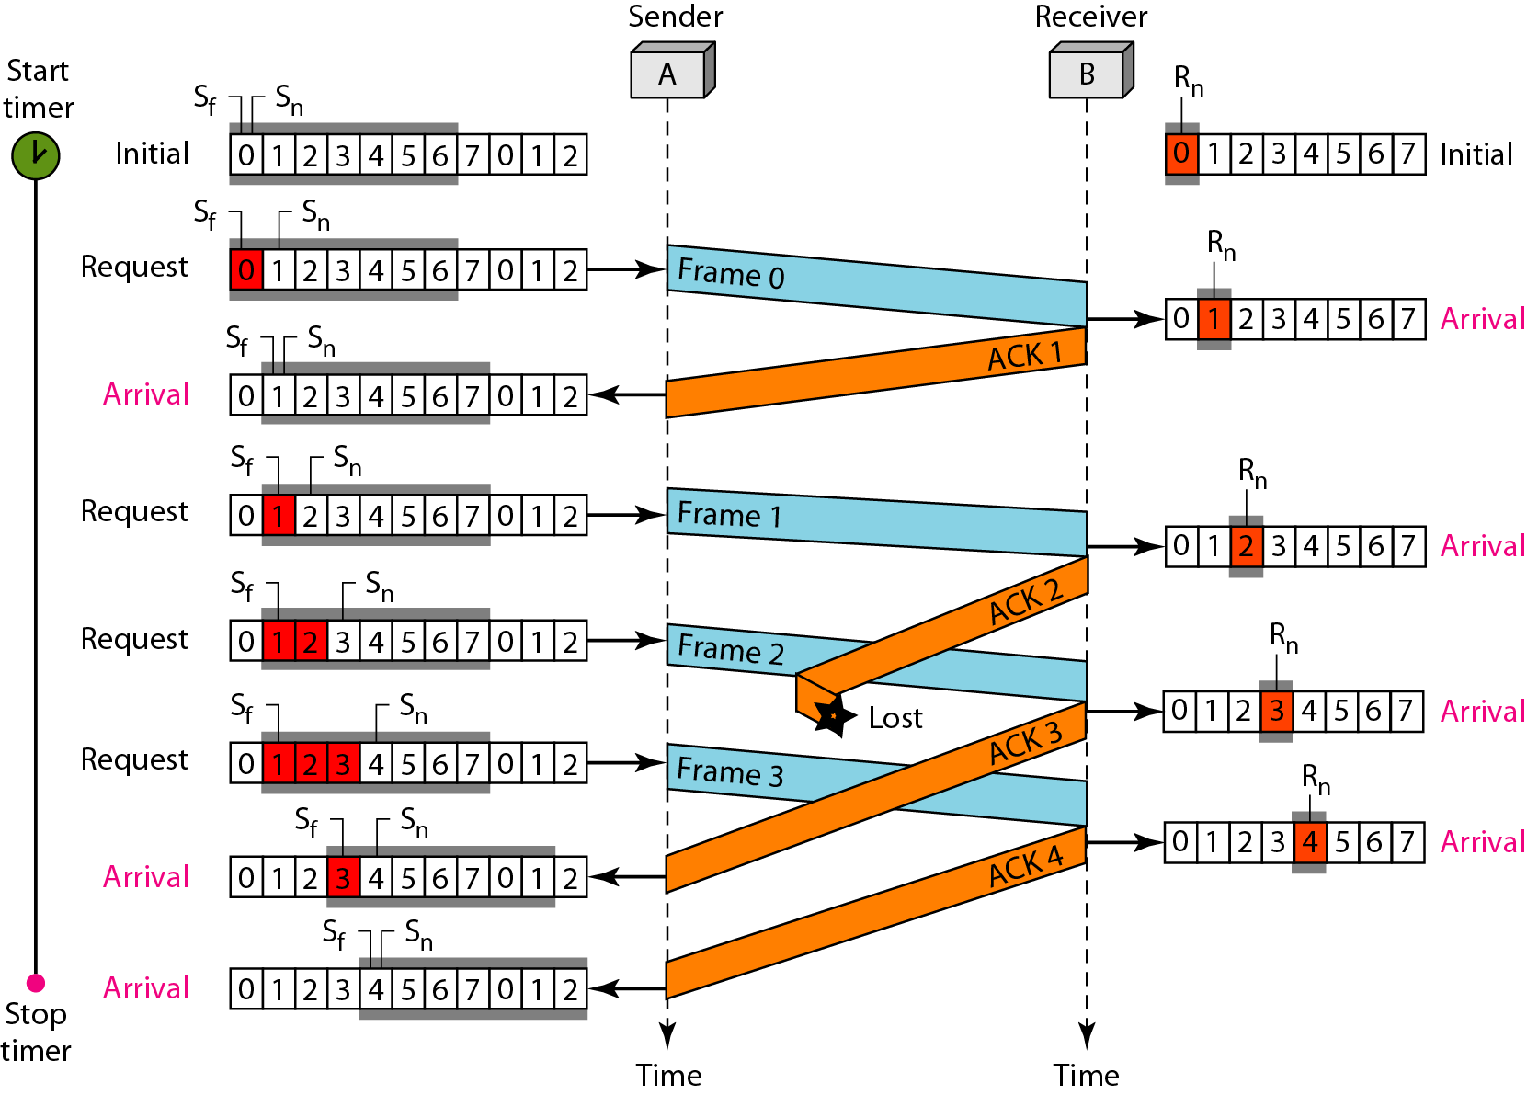
Flow diagram

Slide 43
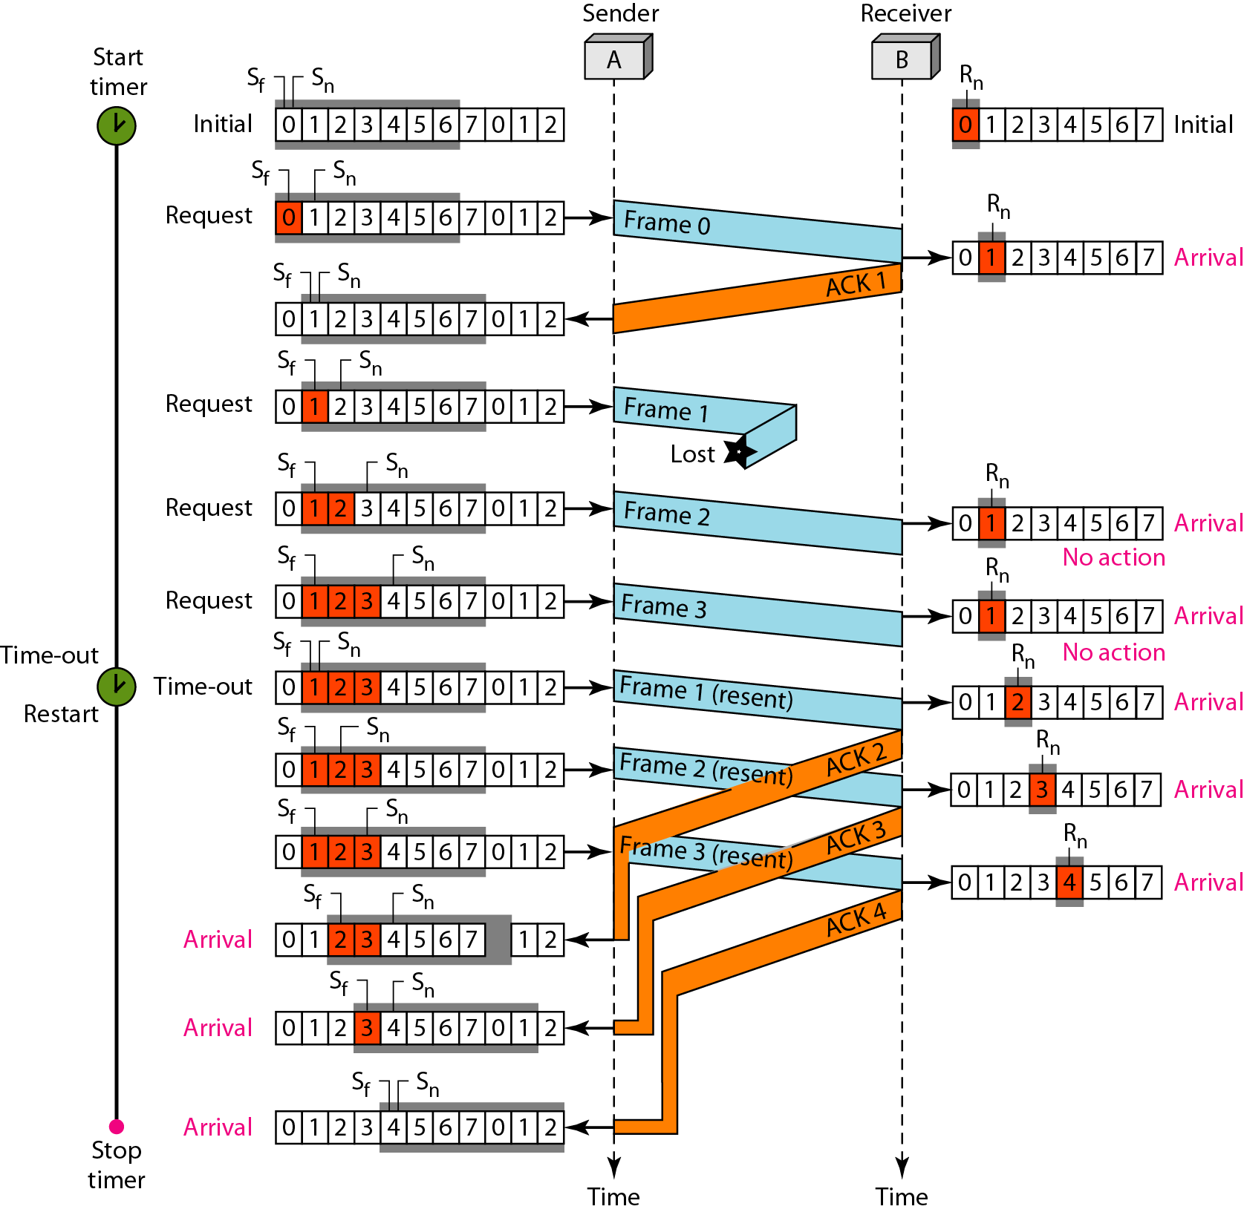
Flow diagram

Slide 44
Note
Stop-and-Wait ARQ is a special case of Go-Back-N ARQ in which the size of the send window is 1.

Slide 45
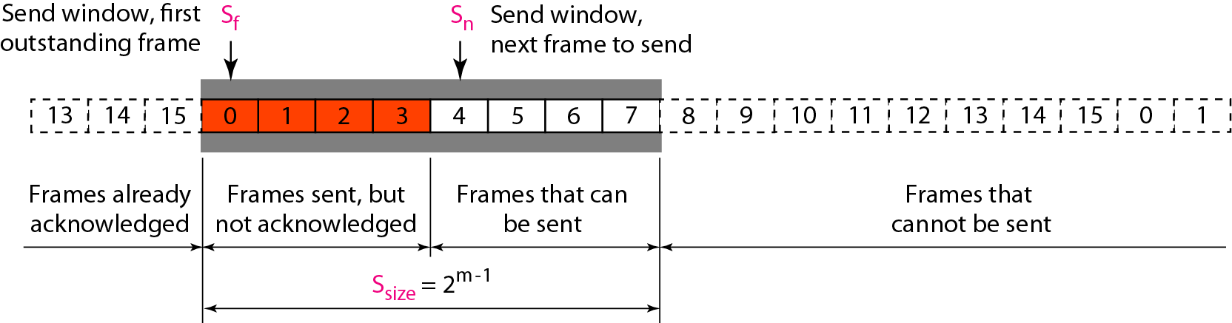
Send window for Selective Repeat ARQ

Slide 46
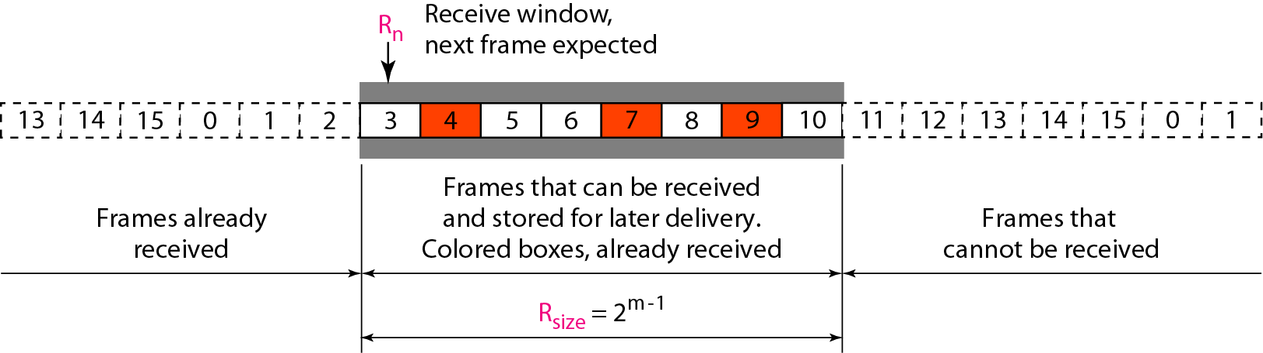
Receive window for Selective Repeat ARQ

Slide 47
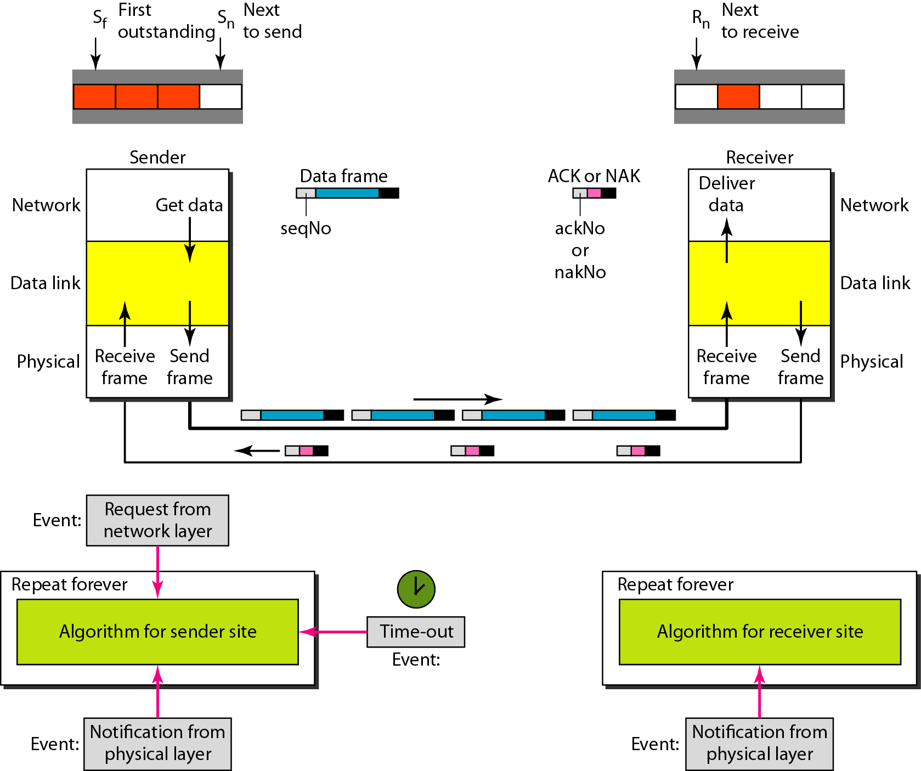
Design of Selective Repeat ARQ

Slide 48
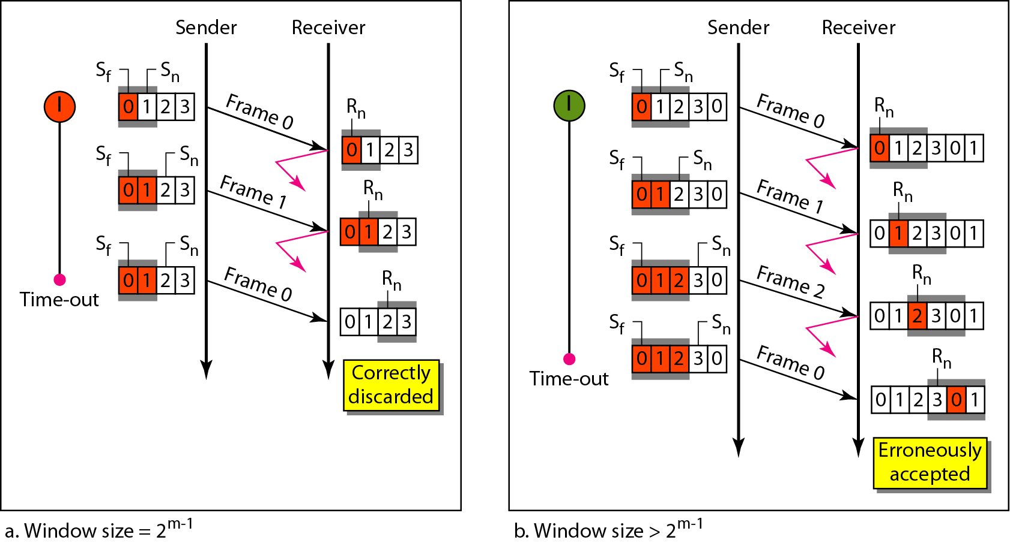
Figure 11.21 Selective Repeat ARQ, window size

Slide 49
Note
In Selective Repeat ARQ, the size of the sender and receiver window
must be at most one-half of 2^{m}.

Slide 50
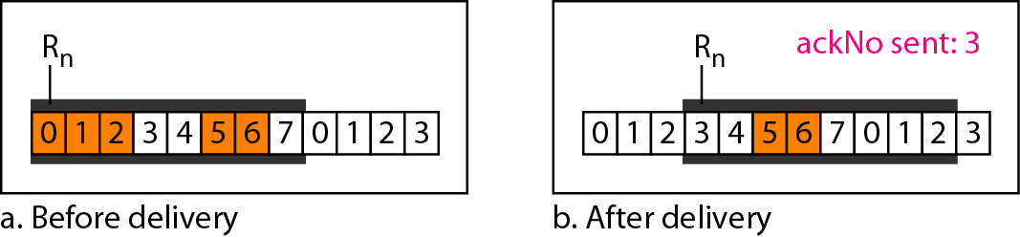
Delivery of data in Selective Repeat ARQ

Slide 51
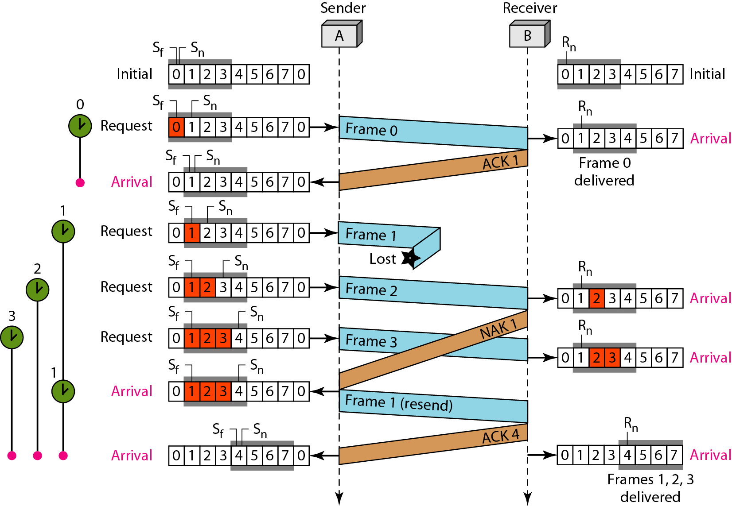
Flow diagram

Slide 52
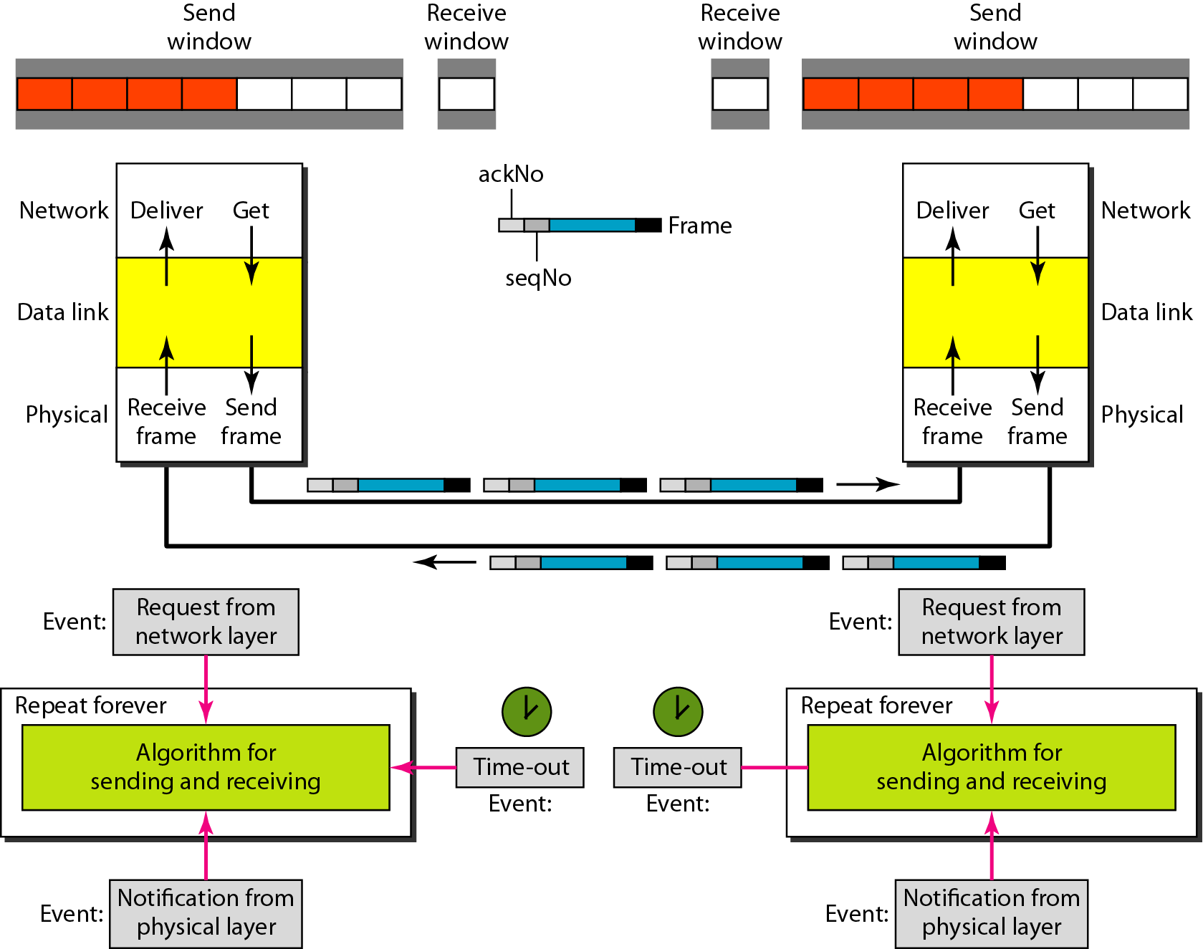
Design of piggybacking in Go-Back-N ARQ

Slide 53
Basic concepts
Networks must be able to transfer data from one device to another with complete accuracy.
Data can be corrupted during transmission.
For reliable communication, errors must be detected and corrected.
Error detection and correction are implemented either at the data link layer or the transport layer of the OSI model.

Slide 54
Types of Errors

Slide 55
Single-bit error

Slide 56
Single bit errors are the least likely type of errors in serial data transmission because the noise must have a very short duration which is very rare. However this kind of errors can happen in parallel transmission.
Example:
If data is sent at 1Mbps then each bit lasts only 1/1,000,000 sec. or 1 μs.
For a single-bit error to occur, the noise must have a duration of only 1 μs, which is very rare.

Slide 57
Burst error

Slide 59
The term burst error means that two or more bits in the data unit have changed from 1 to 0 or from 0 to 1.
Burst errors does not necessarily mean that the errors occur in consecutive bits, the length of the burst is measured from the first corrupted bit to the last corrupted bit. Some bits in between may not have been corrupted.

Slide 60
Burst error is most likely to happen in serial transmission since the duration of noise is normally longer than the duration of a bit.
The number of bits affected depends on the data rate and duration of noise.

Slide 61
Error detection
Error detection means to decide whether the received data is correct or not without having a copy of the original message.
Error detection uses the concept of redundancy, which means adding extra bits for detecting errors at the destination.
Notes:
Make sense of message.
Make sense of message.

Slide 62
Redundancy

Slide 63
Four types of redundancy checks are used
in data communications

Slide 64
Vertical Redundancy Check
VRC

Slide 65
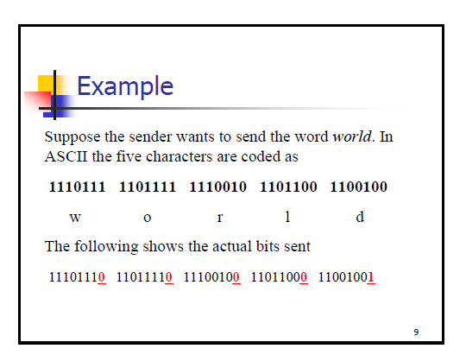

Slide 66
Performance
It can detect burst errors only if the total number of errors is odd.

Slide 67
Longitudinal Redundancy Check
LRC

Slide 68
Performance
LCR increases the likelihood of detecting burst errors.
If two bits in one data units are damaged and two bits in exactly the same positions in another data unit are also damaged, the LRC checker will not detect an error.

Slide 69
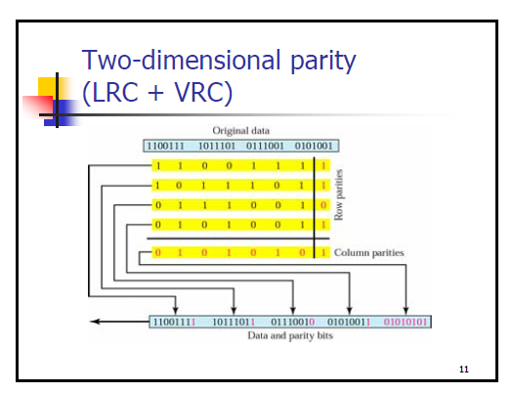

Slide 70
Example for lrc
11100111
11011101
00111001
10101001

Slide 71
Cyclic Redundancy Check
CRC

Slide 72
Cyclic Redundancy Check
Given a k-bit frame or message, the transmitter generates an n-bit sequence, known as a frame check sequence (FCS), so that the resulting frame, consisting of (k+n) bits, is exactly divisible by some predetermined number.
The receiver then divides the incoming frame by the same number and, if there is no remainder, assumes that there was no error.

Slide 73
Binary Division

Slide 74
Polynomial

Slide 75
Polynomial and Divisor

Slide 76
Standard Polynomials

Slide 77
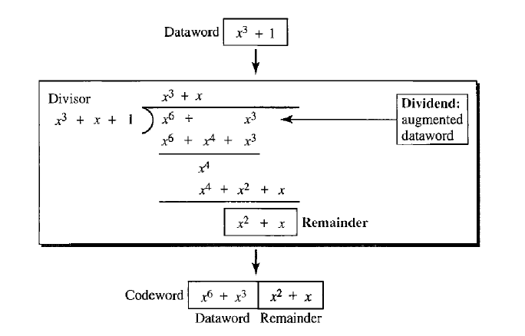

Slide 78
Checksum

Slide 80
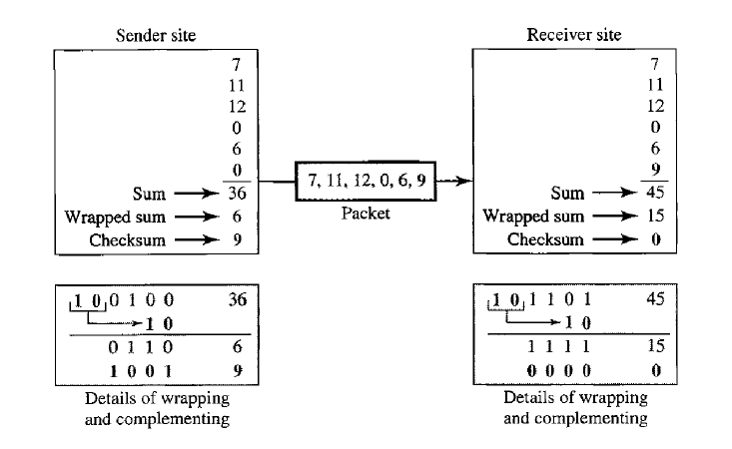

Slide 81
At the sender
The unit is divided into k sections, each of n bits.
All sections are added together using one’s complement to get the sum.
The sum is complemented and becomes the checksum.
The checksum is sent with the data

Slide 82
At the receiver
The unit is divided into k sections, each of n bits.
All sections are added together using one’s complement to get the sum.
The sum is complemented.
If the result is zero, the data are accepted: otherwise, they are rejected.

Slide 83
Example for check sum
10011001
11100010
00100100
10000100

Slide 84
Performance
The checksum detects all errors involving an odd number of bits.
It detects most errors involving an even number of bits.
If one or more bits of a segment are damaged and the corresponding bit or bits of opposite value in a second segment are also damaged, the sums of those columns will not change and the receiver will not detect a problem.

Slide 85
Error Correction
It can be handled in two ways:
receiver can have the sender retransmit the entire data unit.
The receiver can use an error-correcting code, which automatically corrects certain errors.

Slide 86
Single-bit error correction
To correct an error, the receiver reverses the value of the altered bit. To do so, it must know which bit is in error.
Number of redundancy bits needed
Let data bits = m
Redundancy bits = r
∴Total message sent = m+r
The value of r must satisfy the following relation:
2^{r} ≥ m+r+1

Slide 87
Error Correction

Slide 88
Hamming Code

Slide 89
Hamming Code

Slide 90
Hamming Code

Slide 91
Example of Hamming Code

Slide 92
Single-bit error

Slide 93
Error
Detection

Slide 94
Hamming code
Hamming distance - ?
D1= 011011
D2= 101110
?

Slide 95
Data (m)- 101101

Slide 96
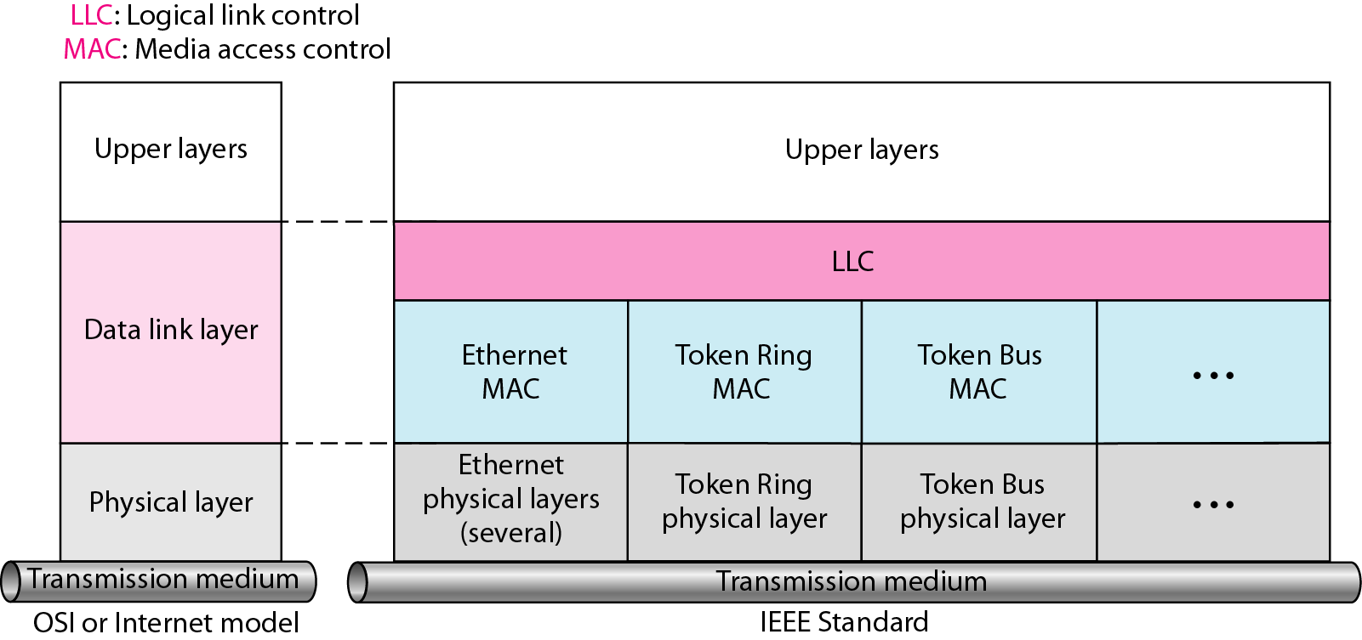
IEEE standard for LANs

Slide 97
STANDARD ETHERNET
The original Ethernet was created in 1976 at Xerox’s Palo Alto Research Center (PARC). Since then, it has gone through four generations. We briefly discuss the Standard (or traditional) Ethernet in this section.
Topics discussed in this section:
MAC Sublayer Physical Layer

Slide 98
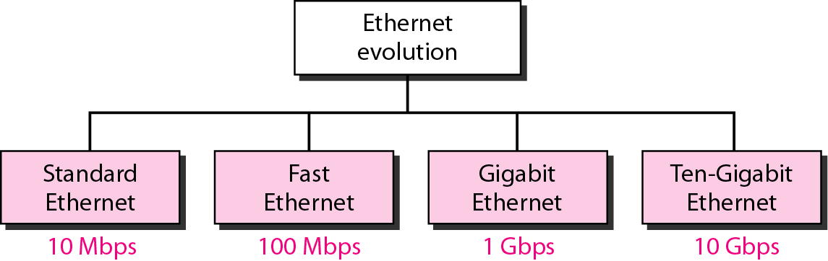
Ethernet evolution through four generations

Slide 99
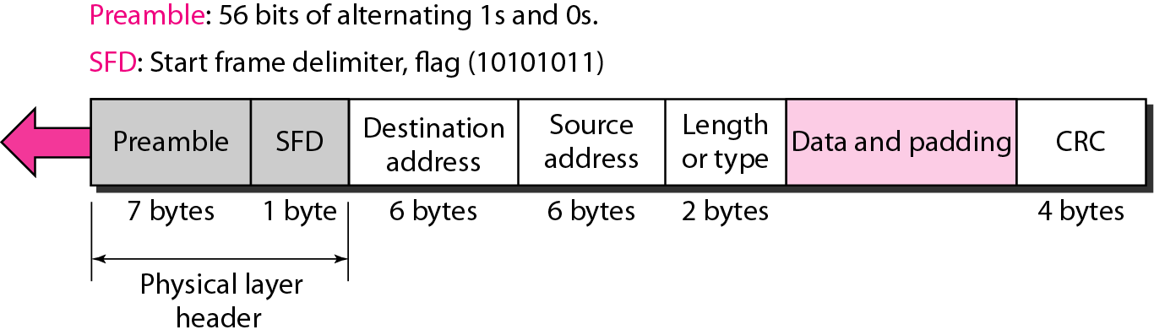
802.3 MAC frame

Slide 100
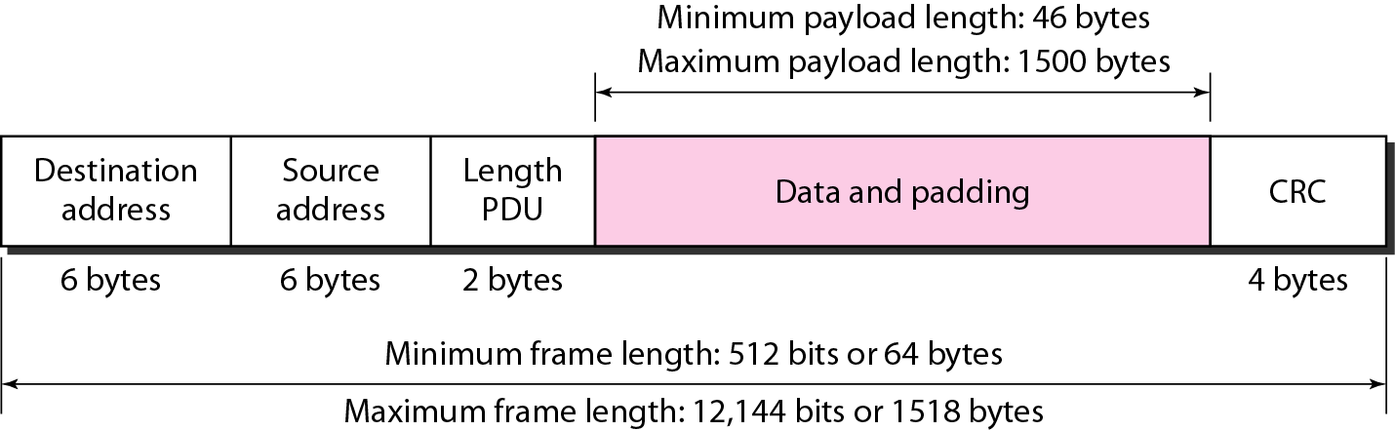
Minimum and maximum lengths

Slide 101
Note
Frame length:
Minimum: 64 bytes (512 bits) Maximum: 1518 bytes (12,144 bits)

Slide 102
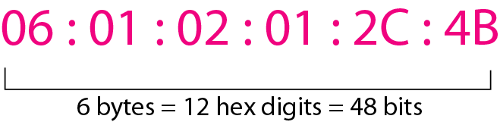
Example of an Ethernet address in hexadecimal notation

Slide 103
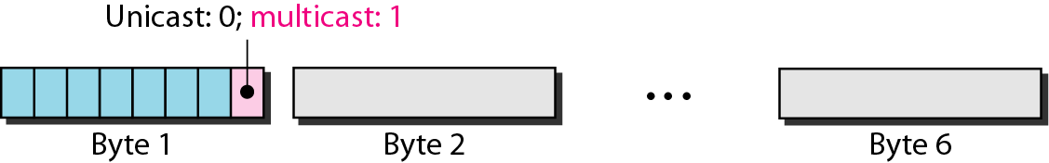
Unicast and multicast addresses

Slide 104
Note
The least significant bit of the first byte defines the type of address. If the bit is 0, the address is unicast; otherwise, it is multicast.

Slide 105
Note
The broadcast destination address is a special case of the multicast address in which all bits are 1s.

Slide 106
Multiple Access

Slide 107
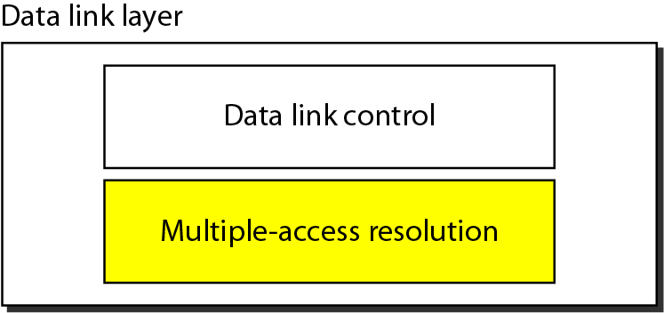
Data link layer divided into two functionality-oriented sublayers

Slide 108
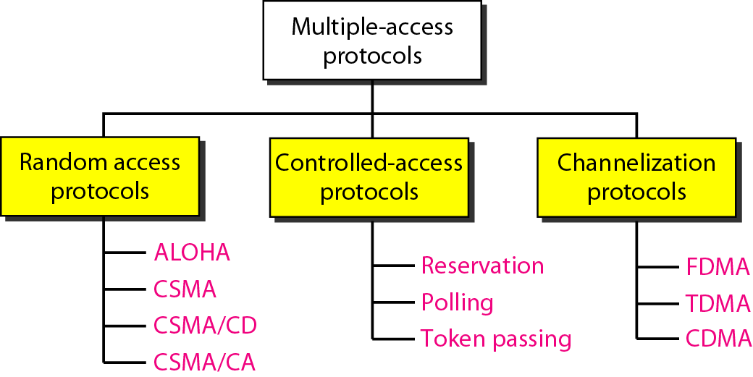
Taxonomy of multiple-access protocols discussed in this chapter

Slide 109
RANDOM ACCESS
In random access or contention methods, no station is superior to another station and none is assigned the control over another. No station permits, or does not permit, another station to send. At each instance, a station that has data to send uses a procedure defined by the protocol to make a decision on whether or not to send.
Topics discussed in this section:
ALOHA Carrier Sense Multiple Access
Carrier Sense Multiple Access with Collision Detection
Carrier Sense Multiple Access with Collision Avoidance

Slide 110
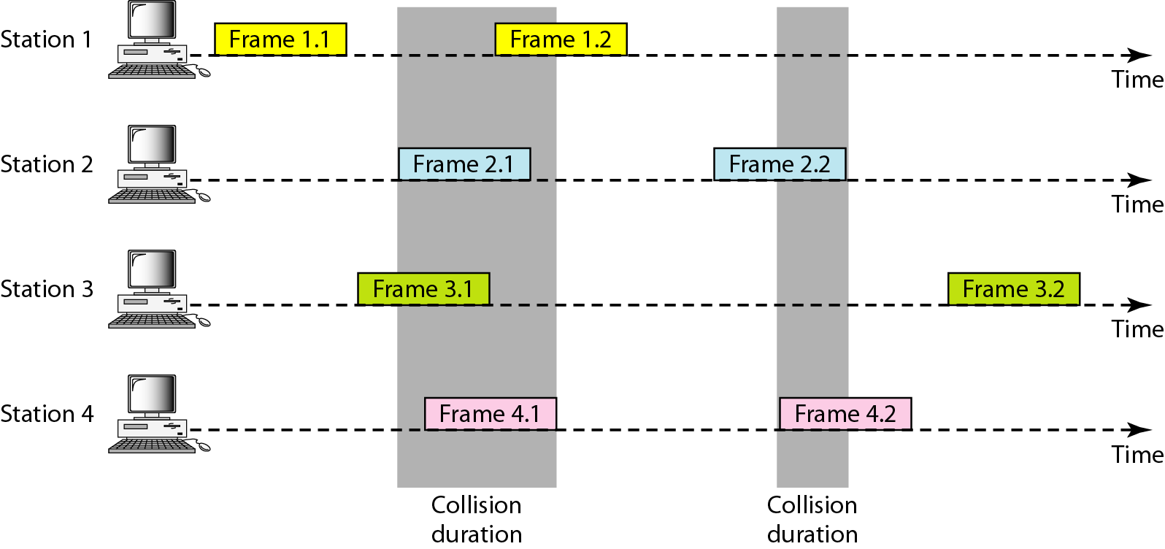
Frames in a pure ALOHA network

Slide 111
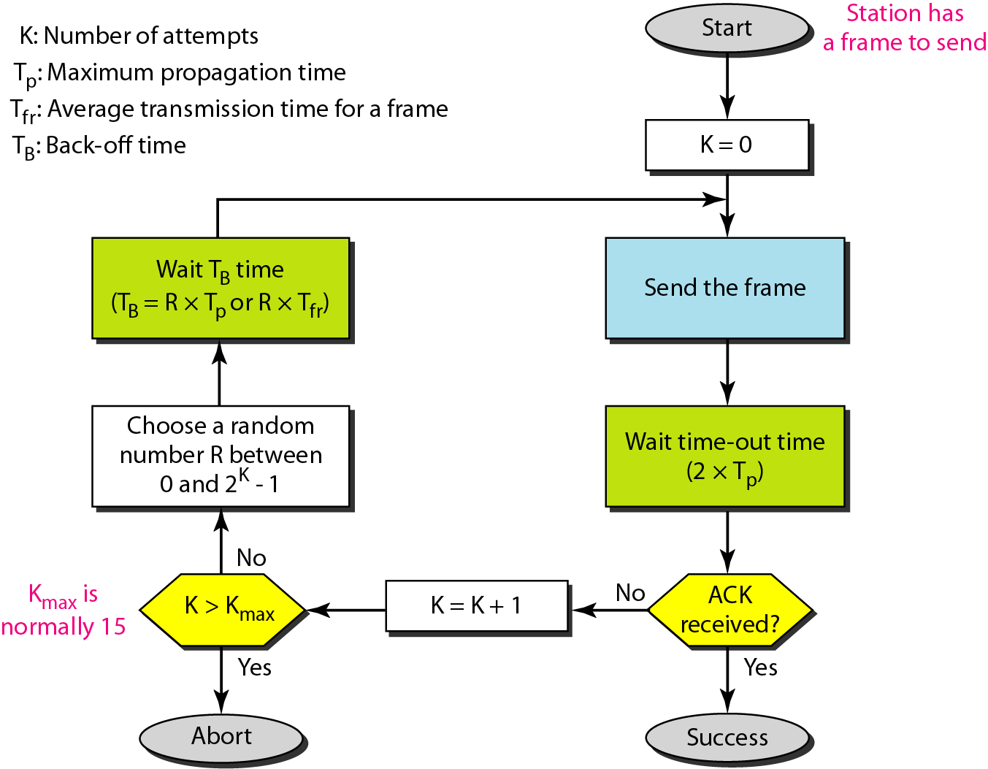
Procedure for pure ALOHA protocol

Slide 112
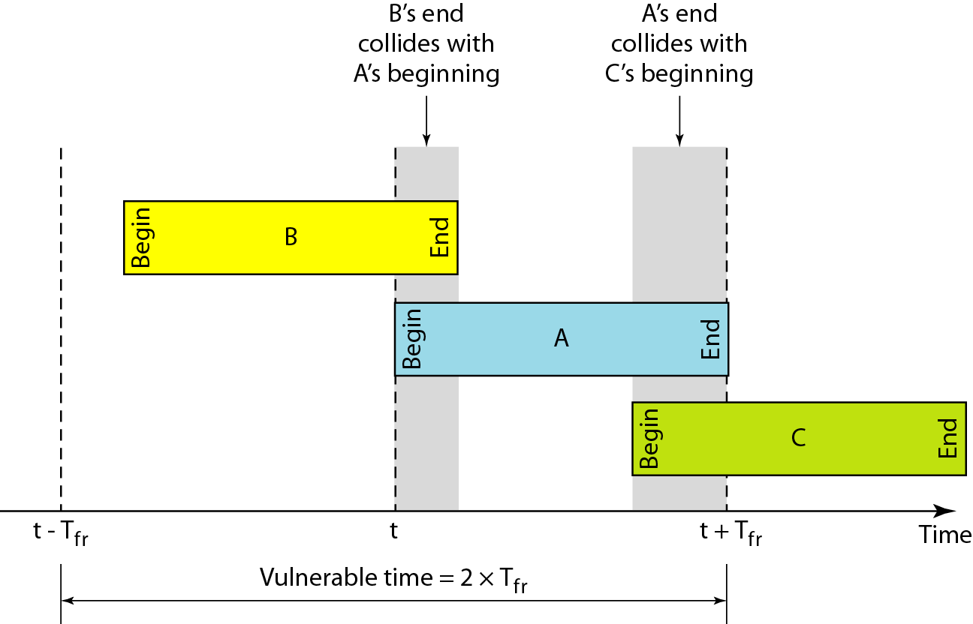
Vulnerable time for pure ALOHA protocol

Slide 113
Note
The throughput for pure ALOHA is S = G × e ^{−2G} .
The maximum throughput
S_{max} = 0.184 when G= (1/2).

Slide 114
(a) ALOHA – It was designed for wireless LAN but is also applicable for shared medium. In this, multiple stations can transmit data at the same time and can hence lead to collision and data being garbled.
Pure Aloha: When a station sends data it waits for an acknowledgement. If the acknowledgement doesn’t come within the allotted time then the station waits for a random amount of time called back-off time (Tb) and re-sends the data. Since different stations wait for different amount of time, the probability of further collision decreases.

Slide 115
Slotted Aloha: It is similar to pure aloha, except that we divide time into slots and sending of data is allowed only at the beginning of these slots. If a station misses out the allowed time, it must wait for the next slot. This reduces the probability of collision.

Slide 116
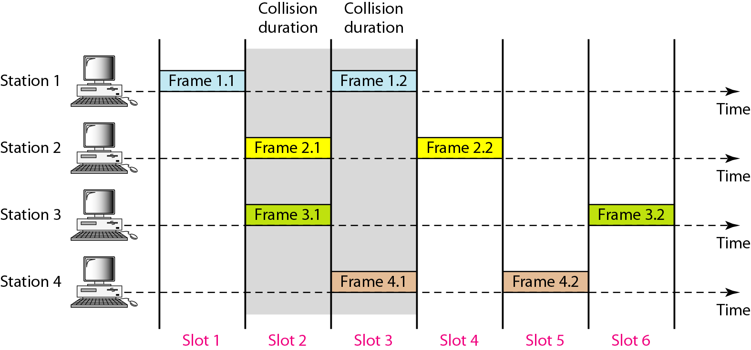
Frames in a slotted ALOHA network

Slide 117
Note
The throughput for slotted ALOHA is S = G × e^{−G} .
The maximum throughput S_{max} = 0.368 when G = 1.

Slide 118
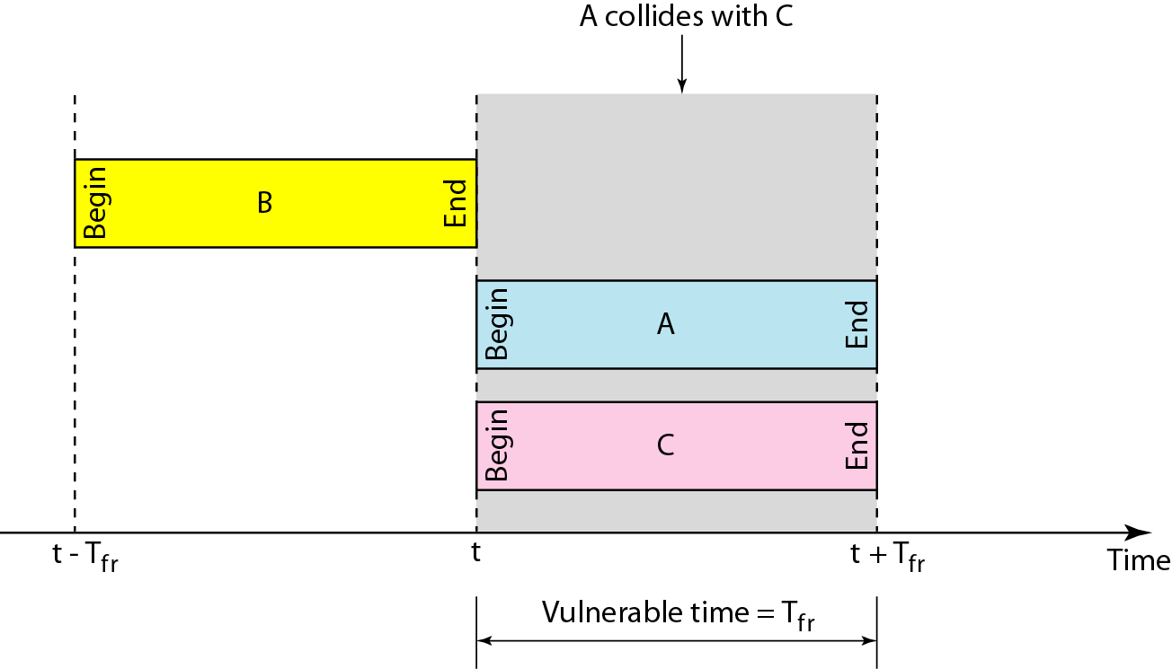
Vulnerable time for slotted ALOHA protocol

Slide 119
CSMA – Carrier Sense Multiple Access ensures fewer collisions as the station is required to first sense the medium (for idle or busy) before transmitting data. If it is idle then it sends data, otherwise it waits till the channel becomes idle. However there is still chance of collision in CSMA due to propagation delay. For example, if station A wants to send data, it will first sense the medium.If it finds the channel idle, it will start sending data. However, by the time the first bit of data is transmitted (delayed due to propagation delay) from station A, if station B requests to send data and senses the medium it will also find it idle and will also send data. This will result in collision of data from station A and B.
CSMA access modes-
1-persistent: The node senses the channel, if idle it sends the data, otherwise it continuously keeps on checking the medium for being idle and transmits unconditionally(with 1 probability) as soon as the channel gets idle.
Non-Persistent: The node senses the channel, if idle it sends the data, otherwise it checks the medium after a random amount of time (not continuously) and transmits when found idle.
P-persistent: The node senses the medium, if idle it sends the data with p probability. If the data is not transmitted ((1-p) probability) then it waits for some time and checks the medium again, now if it is found idle then it send with p probability. This repeat continues until the frame is sent. It is used in Wifi and packet radio systems.

Slide 120
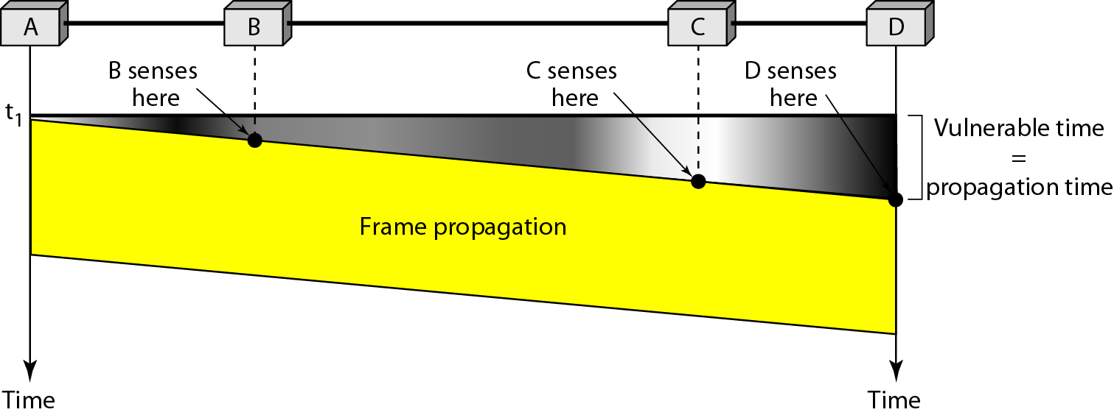
Vulnerable time in CSMA

Slide 121
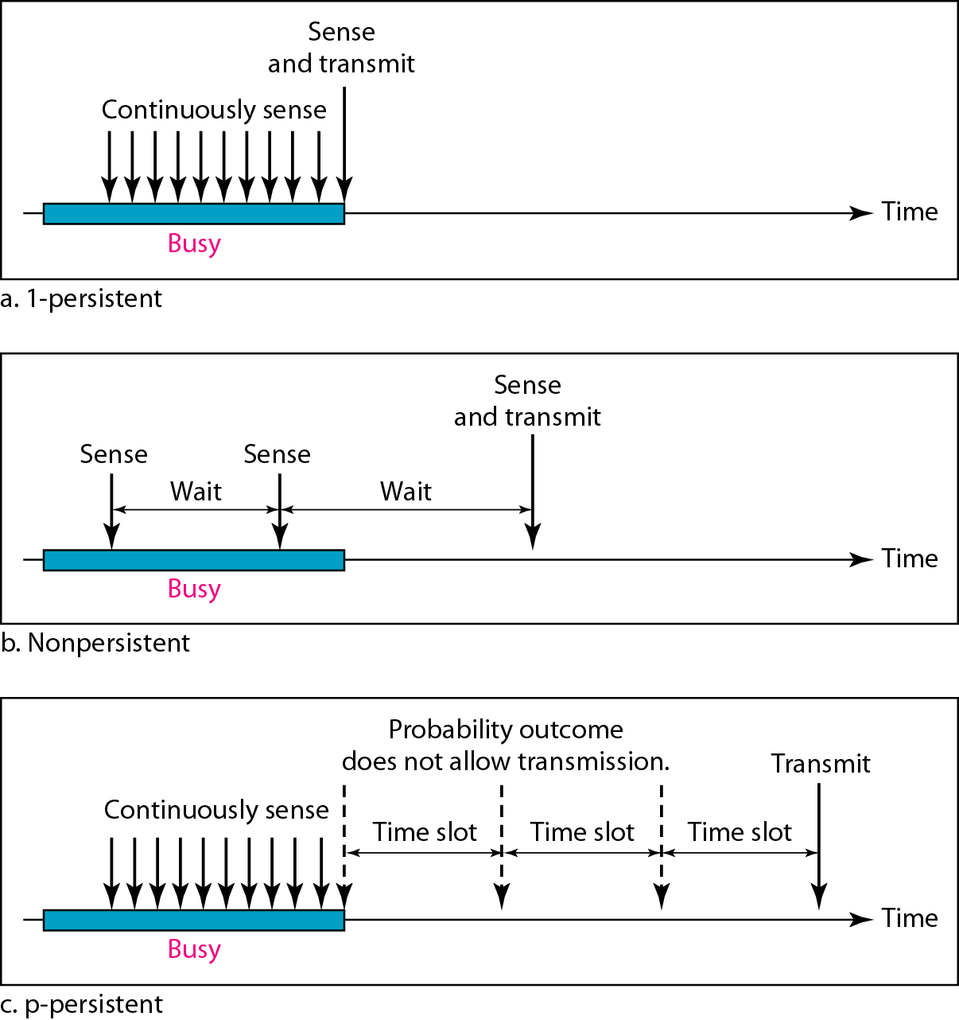
Behavior of three persistence methods

Slide 122
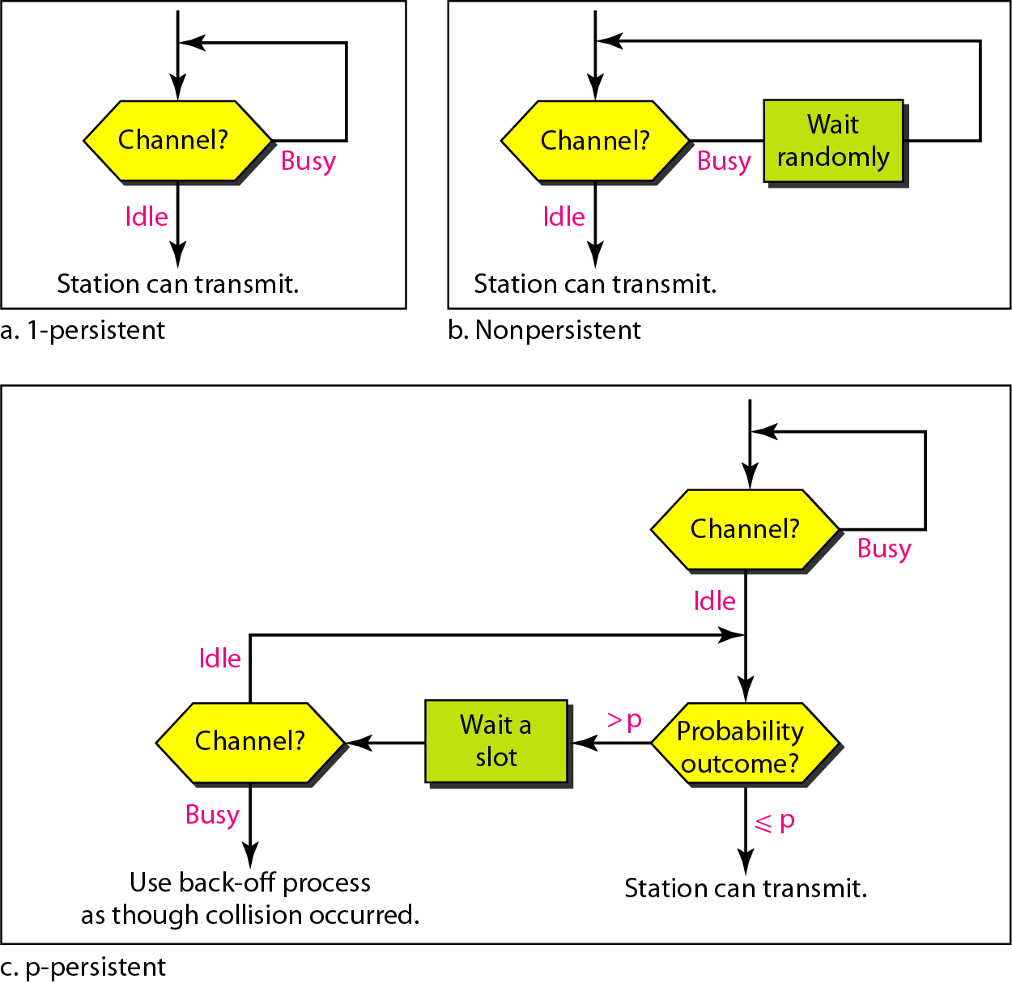
Flow diagram for three persistence methods

Slide 123
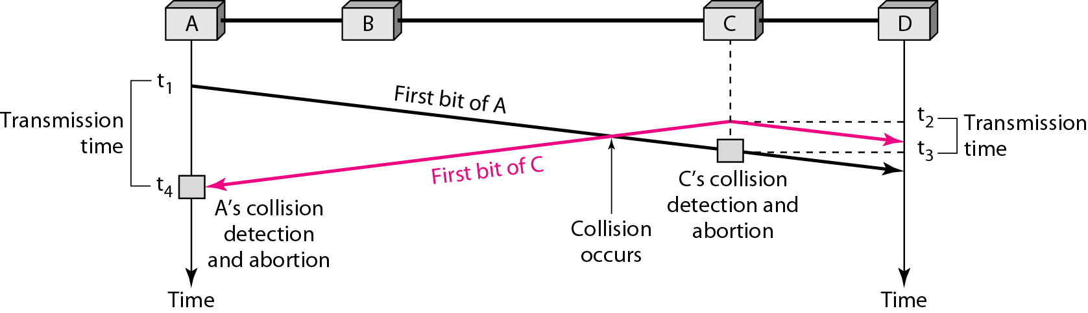
Collision of the first bit in CSMA/CD

Slide 124
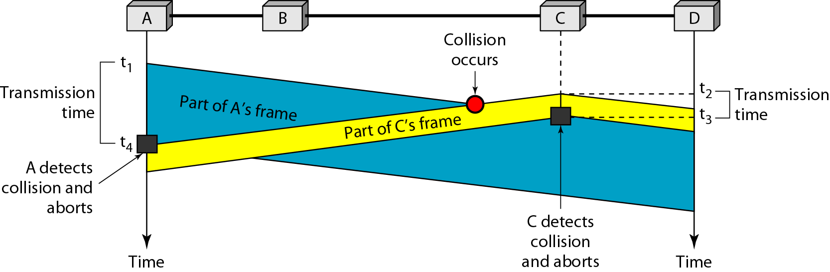
Collision and abortion in CSMA/CD

Slide 125
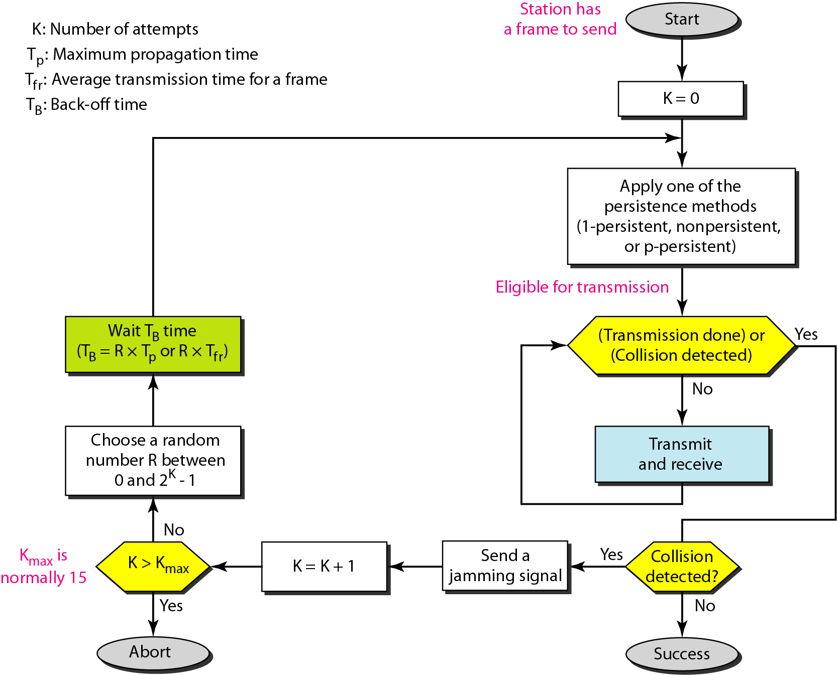
Flow diagram for the CSMA/CD

Slide 126
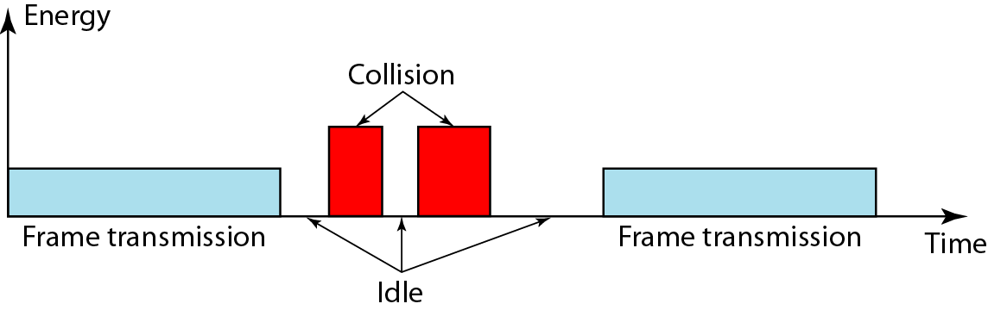
Energy level during transmission, idleness, or collision

Slide 127
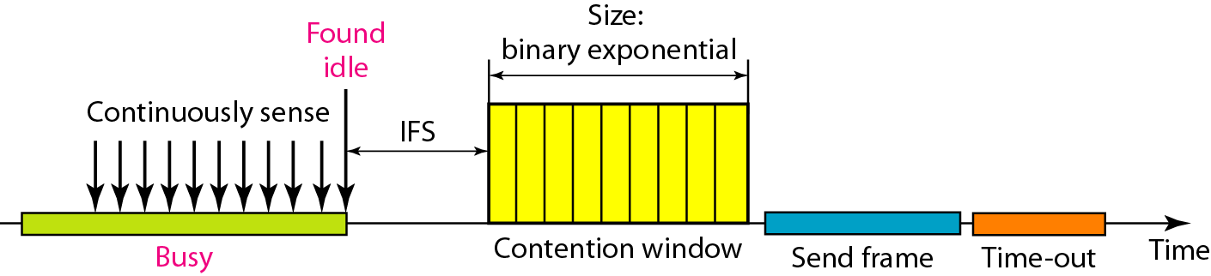
Timing in CSMA/CA

Slide 128
Note
In CSMA/CA, the IFS can also be used to define the priority of a station or a frame.

Slide 129
Note
In CSMA/CA, if the station finds the channel busy, it does not restart the timer of the contention window;
it stops the timer and restarts it when the channel becomes idle.

Slide 130
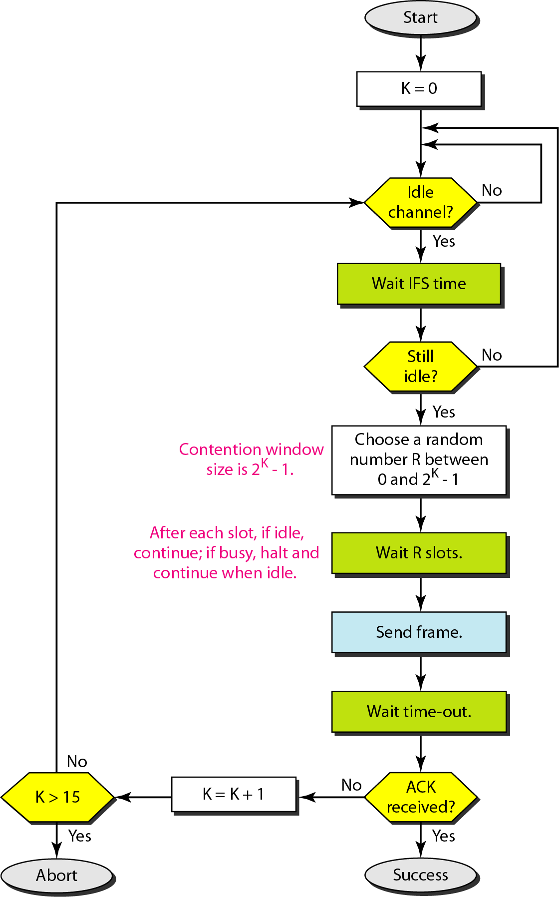
Flow diagram for CSMA/CA

Slide 131
12-2 CONTROLLED ACCESS
In controlled access, the stations consult one another to find which station has the right to send. A station cannot send unless it has been authorized by other stations. We discuss three popular controlled-access methods.
Topics discussed in this section:
Reservation Polling Token Passing

Slide 132

Reservation access method

Slide 133
In the reservation method, a station needs to make a reservation before sending data.
The timeline has two kinds of periods:
Reservation interval of fixed time length
Data transmission period of variable frames.
If there are M stations, the reservation interval is divided into M slots, and each station has one slot.
Suppose if station 1 has a frame to send, it transmits 1 bit during the slot 1. No other station is allowed to transmit during this slot.
In general, i ^{th} station may announce that it has a frame to send by inserting a 1 bit into i ^{th} slot. After all N slots have been checked, each station knows which stations wish to transmit.
The stations which have reserved their slots transfer their frames in that order.
After data transmission period, next reservation interval begins.
Since everyone agrees on who goes next, there will never be any collisions.

Slide 134
Advantages of Reservation:
The main advantage of reservation is high rates and low rates of data accessing time of the respective channel can be predicated easily. Here time and rates are fixed.
Priorities can be set to provide speedier access from secondary.
Predictable network performance: Reservation-based access methods can provide predictable network performance, which is important in applications where latency and jitter must be minimized, such as in real-time video or audio streaming.
Reduced contention: Reservation-based access methods can reduce contention for network resources, as access to the network is pre-allocated based on reservation requests. This can improve network efficiency and reduce packet loss.
Quality of Service (QoS) support: Reservation-based access methods can support QoS requirements, by providing different reservation types for different types of traffic, such as voice, video, or data. This can ensure that high-priority traffic is given preferential treatment over lower-priority traffic.
Efficient use of bandwidth: Reservation-based access methods can enable more efficient use of available bandwidth, as they allow for time and frequency multiplexing of different reservation requests on the same channel.
Support for multimedia applications: Reservation-based access methods are well-suited to support multimedia applications that require guaranteed network resources, such as bandwidth and latency, to ensure high-quality performance.

Slide 135
Disadvantage
Highly trust on controlled dependability.
Decrease in capacity and channel data rate under light loads; increase in turn-around time.

Slide 136

Select and poll functions in polling access method

Slide 137
Polling
Polling process is similar to the roll-call performed in class. Just like the teacher, a controller sends a message to each node in turn.
In this, one acts as a primary station(controller) and the others are secondary stations. All data exchanges must be made through the controller.
The message sent by the controller contains the address of the node being selected for granting access.
Although all nodes receive the message the addressed one responds to it and sends data if any. If there is no data, usually a “poll reject”(NAK) message is sent back.
Problems include high overhead of the

Slide 138
Advantages of Polling:
The maximum and minimum access time and data rates on the channel are fixed predictable.
It has maximum efficiency.
It has maximum bandwidth.
No slot is wasted in polling.
There is assignment of priority to ensure faster access from some secondary.
Disadvantages of Polling:
It consume more time.
Since every station has an equal chance of winning in every round, link sharing is biased.
Only some station might run out of data to send.
An increase in the turnaround time leads to a drop in the data rates of the channel under low loads.

Slide 139

Logical ring and physical topology in token-passing access method

Slide 140
Token Passing
In token passing scheme, the stations are connected logically to each other in form of ring and access to stations is governed by tokens.
A token is a special bit pattern or a small message, which circulate from one station to the next in some predefined order.
In Token ring, token is passed from one station to another adjacent station in the ring whereas incase of Token bus, each station uses the bus to send the token to the next station in some predefined order.
In both cases, token represents permission to send. If a station has a frame queued for transmission when it receives the token, it can send that frame before it passes the token to the next station. If it has no queued frame, it passes the token simply.
After sending a frame, each station must wait for all N stations (including itself) to send the token to their neighbours and the other N – 1 stations to send a frame, if they have one.
There exists problems like duplication of token or token is lost or insertion of new station, removal of a station, which need be tackled for correct and reliable operation of this scheme.

Slide 141
Advantages of Token passing:
It may now be applied with routers cabling and includes built-in debugging features like protective relay and auto reconfiguration.
It provides good throughput when conditions of high load.
Disadvantages of Token passing:
Its cost is expensive.
Topology components are more expensive than those of other, more widely used standard.
The hardware element of the token rings are designed to be tricky. This implies that you should choose on manufacture and use them exclusively.

